Slide 1
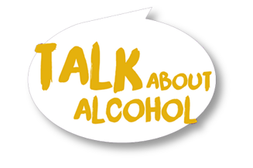

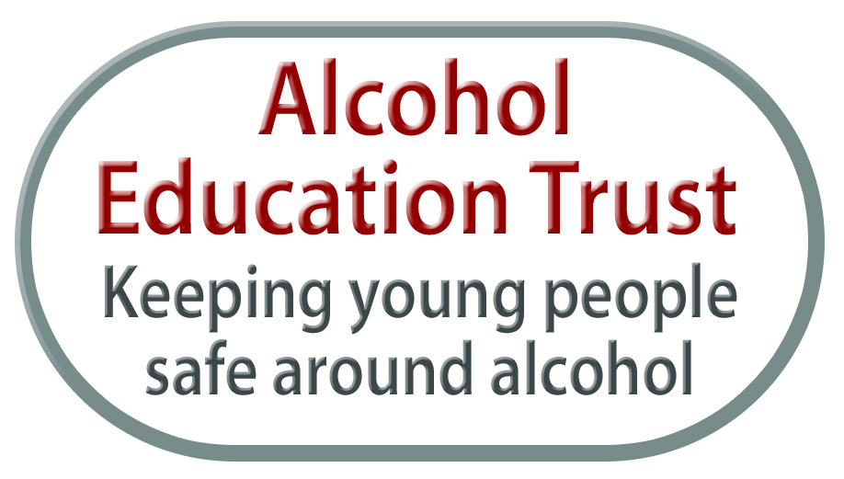
Talk about alcohol
GETTING STARTED

Slide 2
To introduce characters and make them our own so we can imagine alcohol in the lives of older young adults
To answer some questions about alcohol and its effects so we can understand how much we know or don’t know about it.
Learning objectives

Slide 3
Ground rules
We won’t discuss anyone here.
We study alcohol through stories and pictures not personal experience.
We will respect others' opinions.
We will ask questions if we need to.
We will listen to others and speak one at a time.
We’ll turn mobile phones to silent and leave them in our bags.
Notes:
We won’t discuss any of the people present, staff or participants.
We study alcohol through stories and pictures not personal experience.
We will respect others’ opinions.
We will ask questions if we need to.
We will listen to others and speak one at a time.
We’ll turn mobile phones to silent and leave them in our bags during the session to help us all to focus on what we are studying.

Slide 4


Mike Emma

Slide 5



Creating characters
What hobbies do Mike and Emma enjoy?
Notes:
In order to study this subject safely we will use a story with two characters
Emma and Mike (other names can be chosen) who are a similar age to the participants.
The teacher encourages the participants to suggest some hobbies and interests for the characters.
You can encourage the participants to name real places and activities locally.
The characters will come to represent an additional couple of people in the group who might live locally and have similar behaviours and could take similar risks.

Slide 6
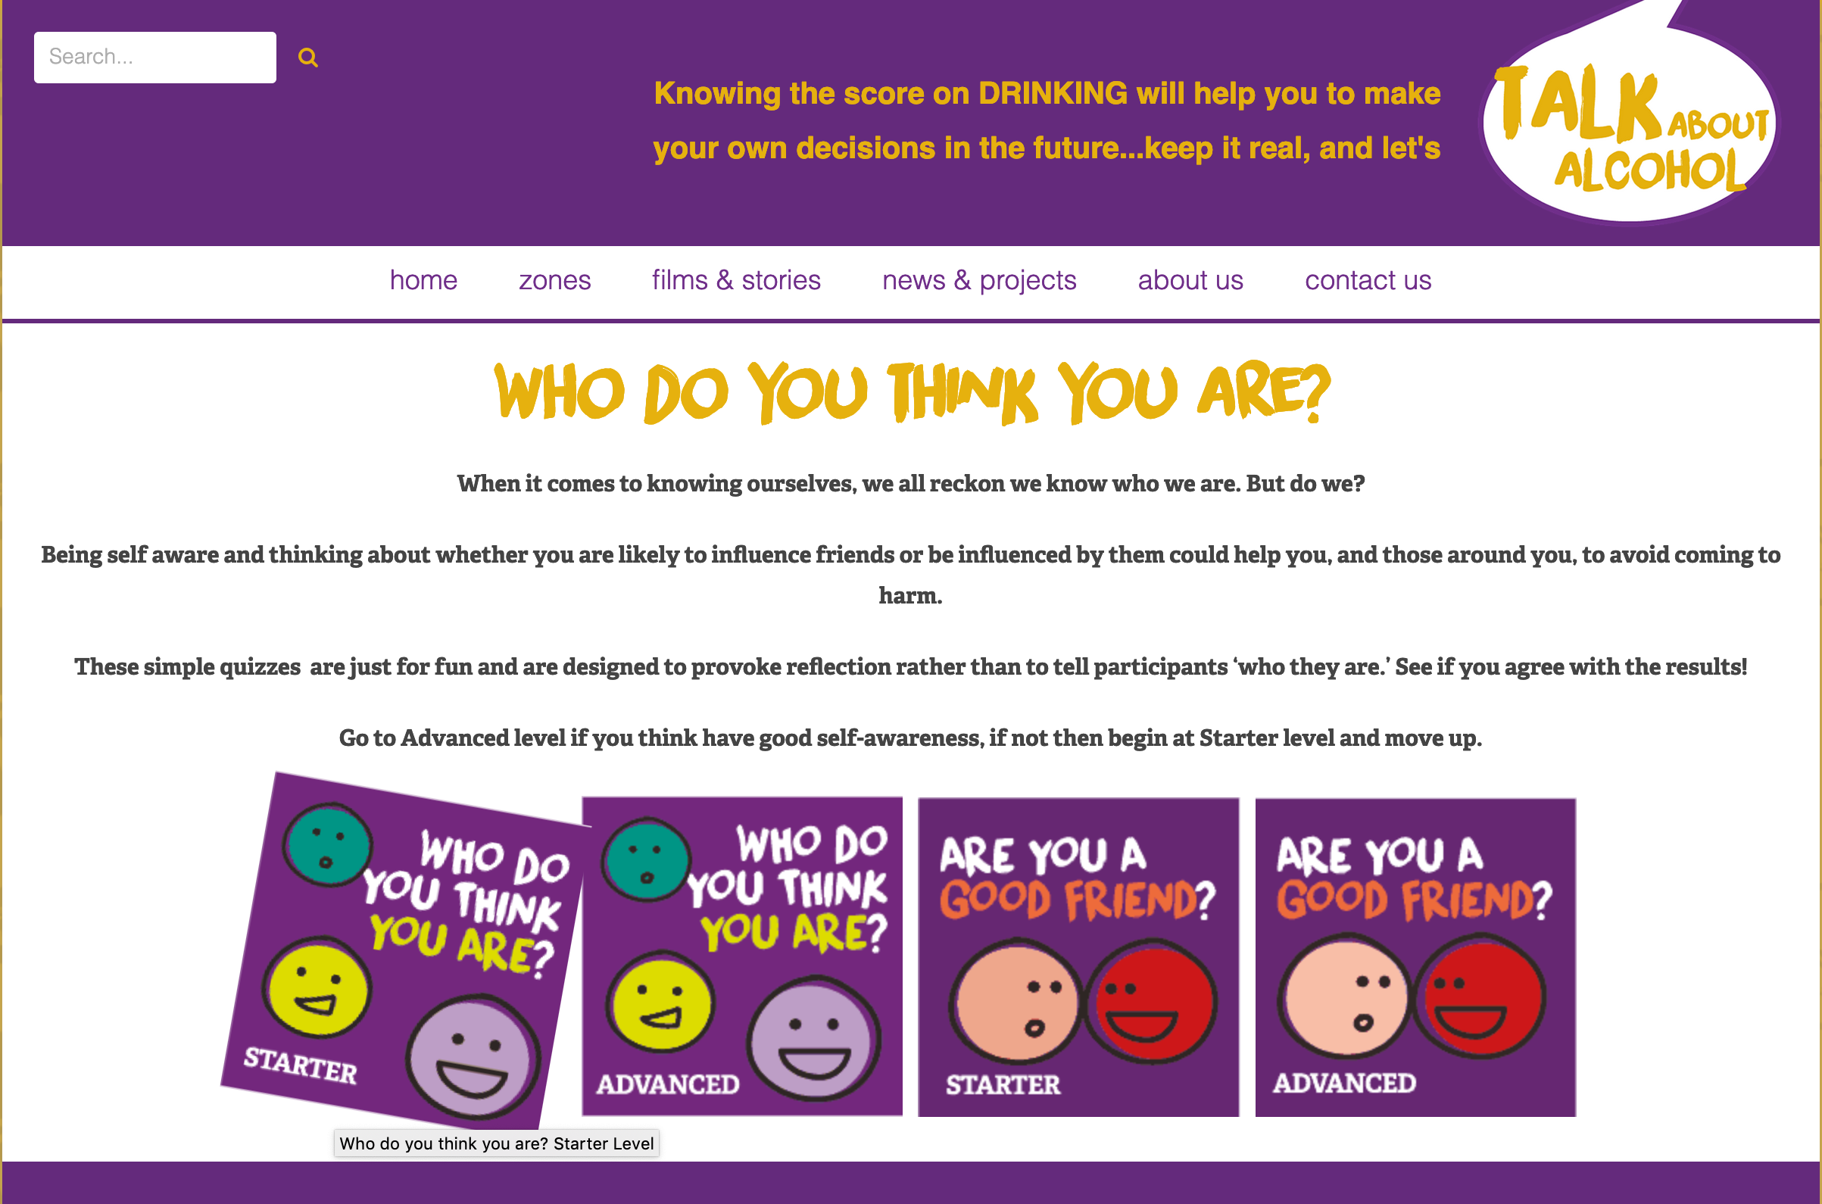
Friends and influences (optional)
Optional activity
Notes:
https://www.talkaboutalcohol.com/who-do-you-think-you-are-starter-level/

Slide 7
Women tend to be more affected by
alcohol than men
Notes:
TRUE: Alcohol travels around the body in water. The female body has more body fat and less water than the male body, so alcohol has less water to spread out in. Therefore, women tend to get drunk faster than men when drinking a similar amount of alcohol.

Slide 8

People who drink lots of alcohol regularly may become addicted to it
Notes:
TRUE Someone who regularly drinks a lot of alcohol may have to drink more to get the same effect, and this can lead to addiction.
Being addicted to alcohol means someone feels that they need to drink and that they find it hard to stop drinking.
They may need a drink as soon as they wake up or feel they need to have a drink in the morning. If they aren’t able to drink alcohol they feel ill with withdrawal symptoms, such as sweating, shaking and nausea. These symptoms stops if they drink alcohol again.

Slide 9

Drinking alcohol reduces stress
Notes:
FALSE After a few drinks someone may feel more relaxed for a while, but alcohol slows down a person’s thinking and changes the way they act.
It doesn’t matter what mood someone is in to start with, with a lot of alcohol, it’s possible that instead of getting happier, they could become angry, anxious or depressed.

Slide 10

People are more likely to take risks after drinking
Notes:
TRUE Alcohol affects judgement so after drinking alcohol, people tend to have fewer inhibitions and this can lead to risky behaviour. This can result in:
• An accident or injury
• Risky or unprotected sex
• Vulnerability to others
• Criminal damage or violence.

Slide 11

It is illegal to buy alcohol under 18
Notes:
TRUE It is illegal for licensed premises to sell alcohol to anyone under 18 years old and the Police have powers to confiscate alcohol from under 18s in public spaces (e.g. on the street or in parks).
It is against the law for those under 18 to consume alcohol in a licensed premise, with the exception of 16 and 17 year-olds who are allowed to drink beer, wine or cider during a meal with adults (but they may not buy the alcohol themselves).
It is also illegal for an adult (aged 18 or over) to knowingly buy alcohol for someone under age - So if someone under 18 asked an older friend to buy alcohol for them, they’d be asking them to break the law.

Slide 12
It’s impossible to know how much alcohol is in a bottle

Slide 13

Drinking too much alcohol can affect someone’s health
Notes:
TRUE. Drinking a lot of alcohol in a short space of time can increase some one’s risk of accidents and injury. Drinking a large amount can cause alcohol poisoning, leading to coma or even death.
In the UK, most young people drink responsibly, but for those aged 16-24, 16% of men (less than 1 in 5) consume more than 12 units on one occasion and 14% of women consume more than 9 units. This can lead to short term personal risks such as accidents and alcohol poisoning. 16%-20% of accidental deaths are alcohol-related and in 2018, 530 people died from alcohol poisoning in the UK.
Among adults in the UK 5% of all men (1 in 20) drink more than 50 units a week and 3% of women drink more than 35 units a week in the UK. Drinking at this level increases the risk of cancers (colon, breast, upper digestive tract), of heart disease and alcoholic liver diseases long-term. That’s why in 2018, 7,551 people died from an alcohol-related illness, mainly from alcoholic liver disease.

Slide 14
Eating before drinking alcohol stops a person from getting drunk
Notes:
Eating before drinking slows down the absorption of alcohol into the bloodstream and will stop someone from getting drunk as quickly - It also gives the liver more of a chance to break down the alcohol in the body, as alcohol is held in the stomach for longer.
It’s therefore a good idea to eat before drinking, but this doesn’t reduce the amount of alcohol or units that are consumed– so if someone drinks a lot, they’ll still get drunk.

Slide 15
Drinking water and alternating with soft drinks will reduce the risk of a hangover
Notes:
TRUE Drinking plenty of water and pacing – that is, alternating alcoholic drinks with non-alcoholic alternatives – slows down a person’s intake of alcohol as well as keeping the body hydrated. This in turn reduces the risk of drinking too much and getting a hangover the next day.
Alternating with soft drinks will help save money and bars and clubs have to offer free tap water too!

Slide 16
It is possible to sleep off a hangover and feel all right the next day
Notes:
Hangovers can last for a lot longer than just the morning after. Advice for adults is that after a lot of alcohol has been consumed, they shouldn’t drink alcohol for another 48 hours. Hangovers are best avoided in the first place by limiting drinking to within the responsible guidelines, pacing drinks with non-alcoholic ones and eating before or when drinking or not drinking at all.

Slide 17
We have created two characters, decided what they like to do and what they are like as personalities.
We have tested how much we know about alcohol.
What have we covered today?

Slide 18
Talk about alcohol
GETTING STARTED

