Slide 1
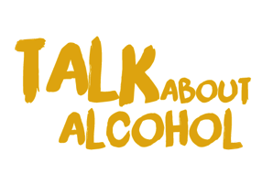
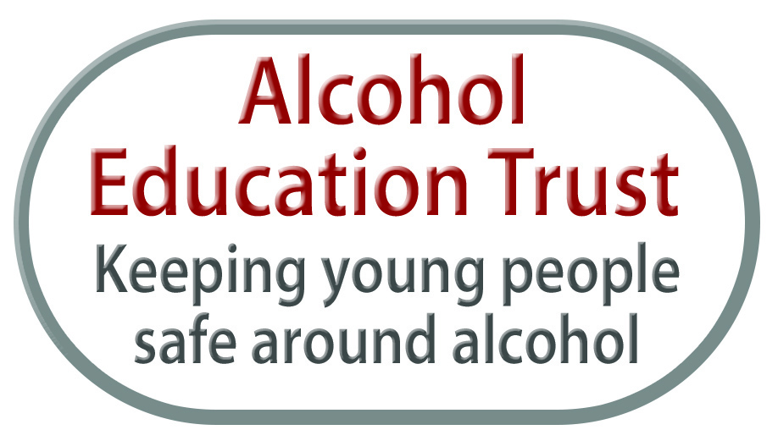
Talk about alcohol Foundation learning

Slide 2
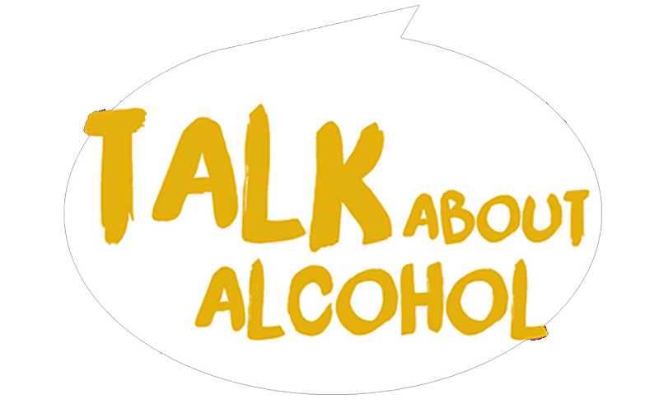
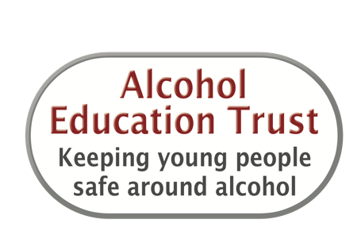
Learning objectives
We will
Learn about units of alcohol and how alcohol is processed by the body.
Explore some laws for buying and drinking alcohol.
Learn about the health and safety risks around alcohol.

Slide 3
Intended learning outcomes
I will be able to
Explain what a unit of alcohol is and say how many units are in different drinks.
Explain how alcohol can affect the body.
Say when it is against the law to buy and drink alcohol.
Give examples of when drinking alcohol is risky or dangerous.

Slide 4
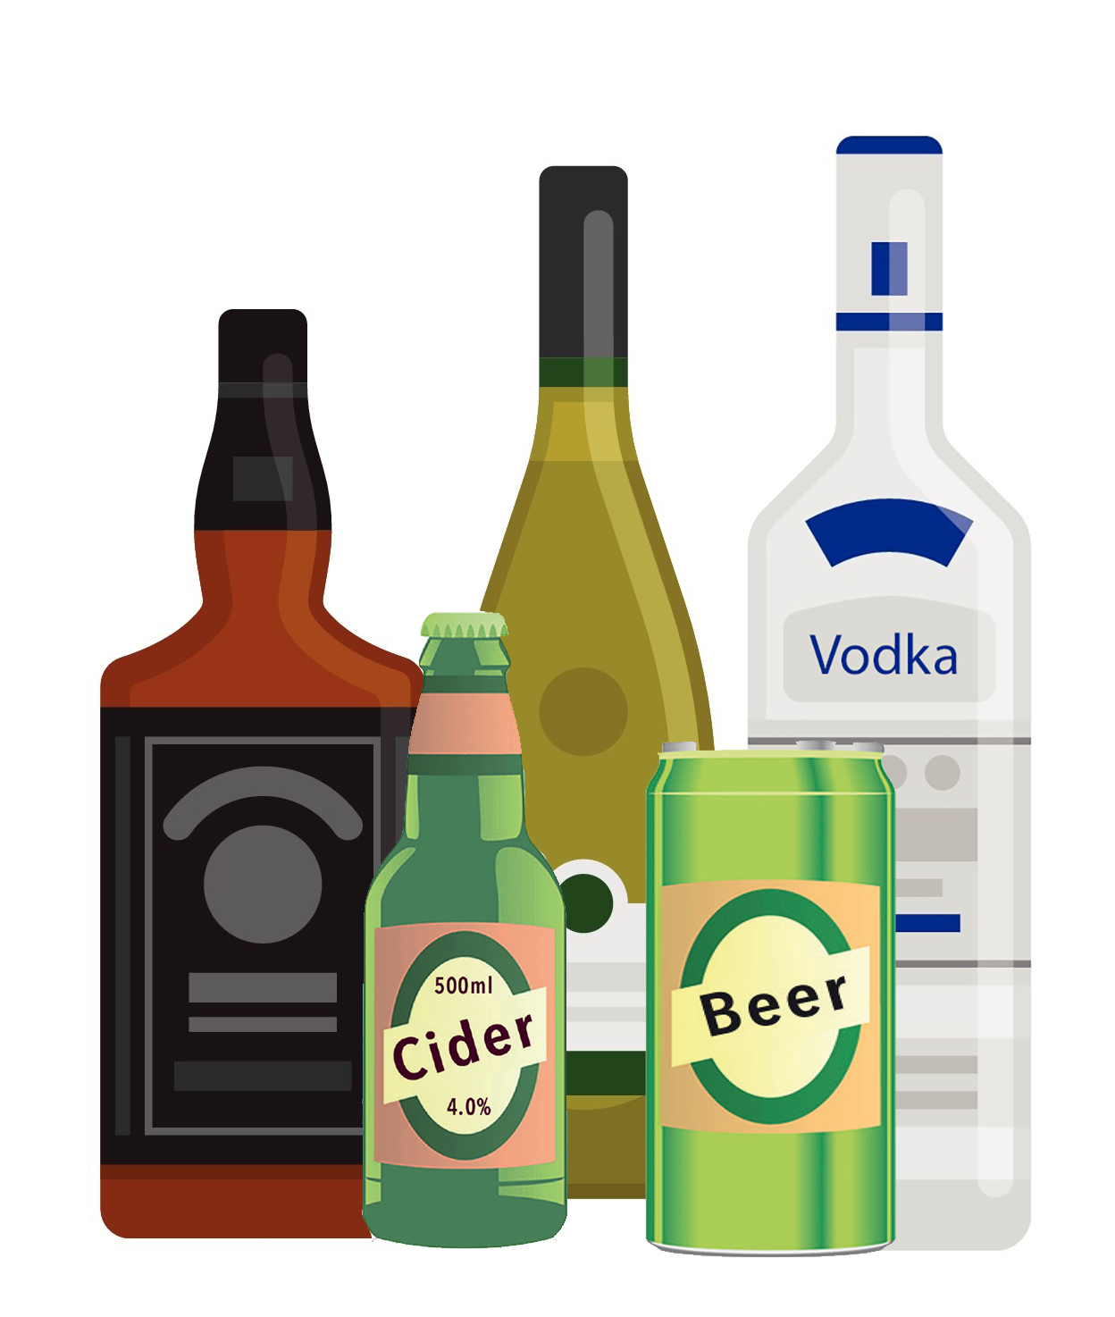
What is alcohol?
Alcohol is a legal drug.
Alcohol is made from fermented fruit like grapes and apples, or cereals.
Alcohol drinks can have different flavours and strengths.
Alcohol affects how you feel, act, react and behave.
Alcohol slows down your thoughts and movement.
Notes:
Alcohol is a legal drug
Alcohol is a psycho active substance – something that affects how you feel, act, react and behave
Alcohol is a depressant – in that it slows down your reactions and coordination
Caffeine is a different type of legal drug - a stimulant that makes you feel awake!
Alcohol is made from fermented fruit like grapes (wine), cereals (beer) and apples (cider). It comes is different flavours and strengths – a small drink like vodka is much stronger than a larger beer for example

Slide 5
Icebreaker
Can you name some different types of alcoholic drink?
Have you seen adverts about alcohol?
Have you seen campaigns about alcohol and driving?
Have you seen anyone who is drunk?
Have you seen tv dramas or films where the story was about alcohol?
Have you been at a wedding or celebration where there was alcohol?
Notes:
‘How we are influenced by alcohol’ game.
This activity can be done through a rapid fire ‘hot seat format’. You can adjust the statements according to the age and ability of the group.
Get students to stand in a large circle around the room
Read out the statements, one at a time.
If students feel that the statement applies to them, they should cross the circle to the other side.
By the end of the statements most students will probably have moved at least once – most more than that.
Ask the students what they think this game demonstrates. (Most people, even if they don’t drink are affected by alcohol at some point. If alcohol is consumed, it is important to drink in moderation).

Slide 6
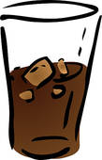
What is a unit of alcohol?
water or a soft drink
or
= 0 units
a small alcopop or a small glass of beer
or
= 1 unit
a pint of beer or a small glass of wine (175ml)
or
= 2 units
a large glass of wine (250ml) or a can of strong beer
or
= 3 units
Notes:
= 0 units
= 1 units
Half a pint of beer, cider, lager or a small alcopop
= 2 units
One pint of beer, cider or lager or a small glass of wine
Water, juice or fizzy drinks
A can of high strength beer, cider or lager
= 3 units
Units tell us how much alcohol is in a drink.
Different drinks have different numbers of units depending on how ‘strong’ they are.
Some drinks such as beer or wine can vary in strength and so units can vary. The size of the drink will also affect the number of units it contains.
Some drinks are low or no alcohol

Slide 7
How much is too much for adults?
Most drinks tell you how many units are in them - check the label
Adults should not regularly exceed 14 units a week for both men and women.
Drinks should be spread over a number of days in the week.
There are no safe limits for under 18s.
Most adults in the UK drink within these limits.
Many adults choose not to drink alcohol for health, religious or cultural reasons.
Notes:
Drinks labels can help someone to understand how many units of alcohol are in a single glass (specific size) or a container.
The UK government guidelines are for healthy adults, both men and women . It is recommended that adults do not exceed 14 units a week and that drinks are spread over a number of days (i.e. that a person doesn’t consumer 14 units in just one or two days as this is binge drinking and is harmful)
Emphasise that the guidelines are for adults as alcohol has a greater effect on the brain and organs of young people, making them more likely to do risky things, be sick or unwell.
Emphasise that the majority of adults drink within the guidelines. In 2018, 69% of men drank and 85% of women drank within the government low risk drinking guideline (a maximum of 14 units for both women and for men).

Slide 8
How much is too much for adults?
For healthy adults, both men and women, one or two drinks per day is ok.
1 small alcopop or
2 small beers
Notes:
For healthy adults doctors say 14 units per week is OK, but this should be spread over a number of days rather than consumed in binges.
Make it clear that talk of drinks and guidelines are for adults over the age of 18 and not young people, as alcohol has a greater effect on the brain and organs of young people, making them more likely to do risky things, be sick or unwell.
If someone drinks a lot reactions slow down, they may be sick, pass out, have an accident, get involved in a fight or dangerous things

Slide 9
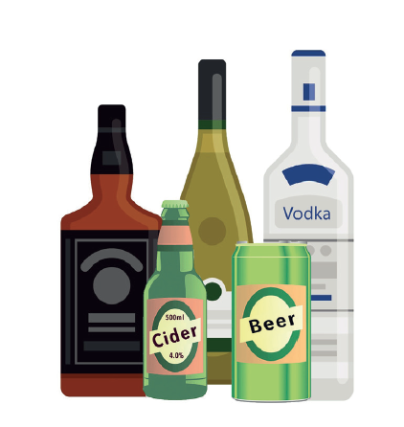
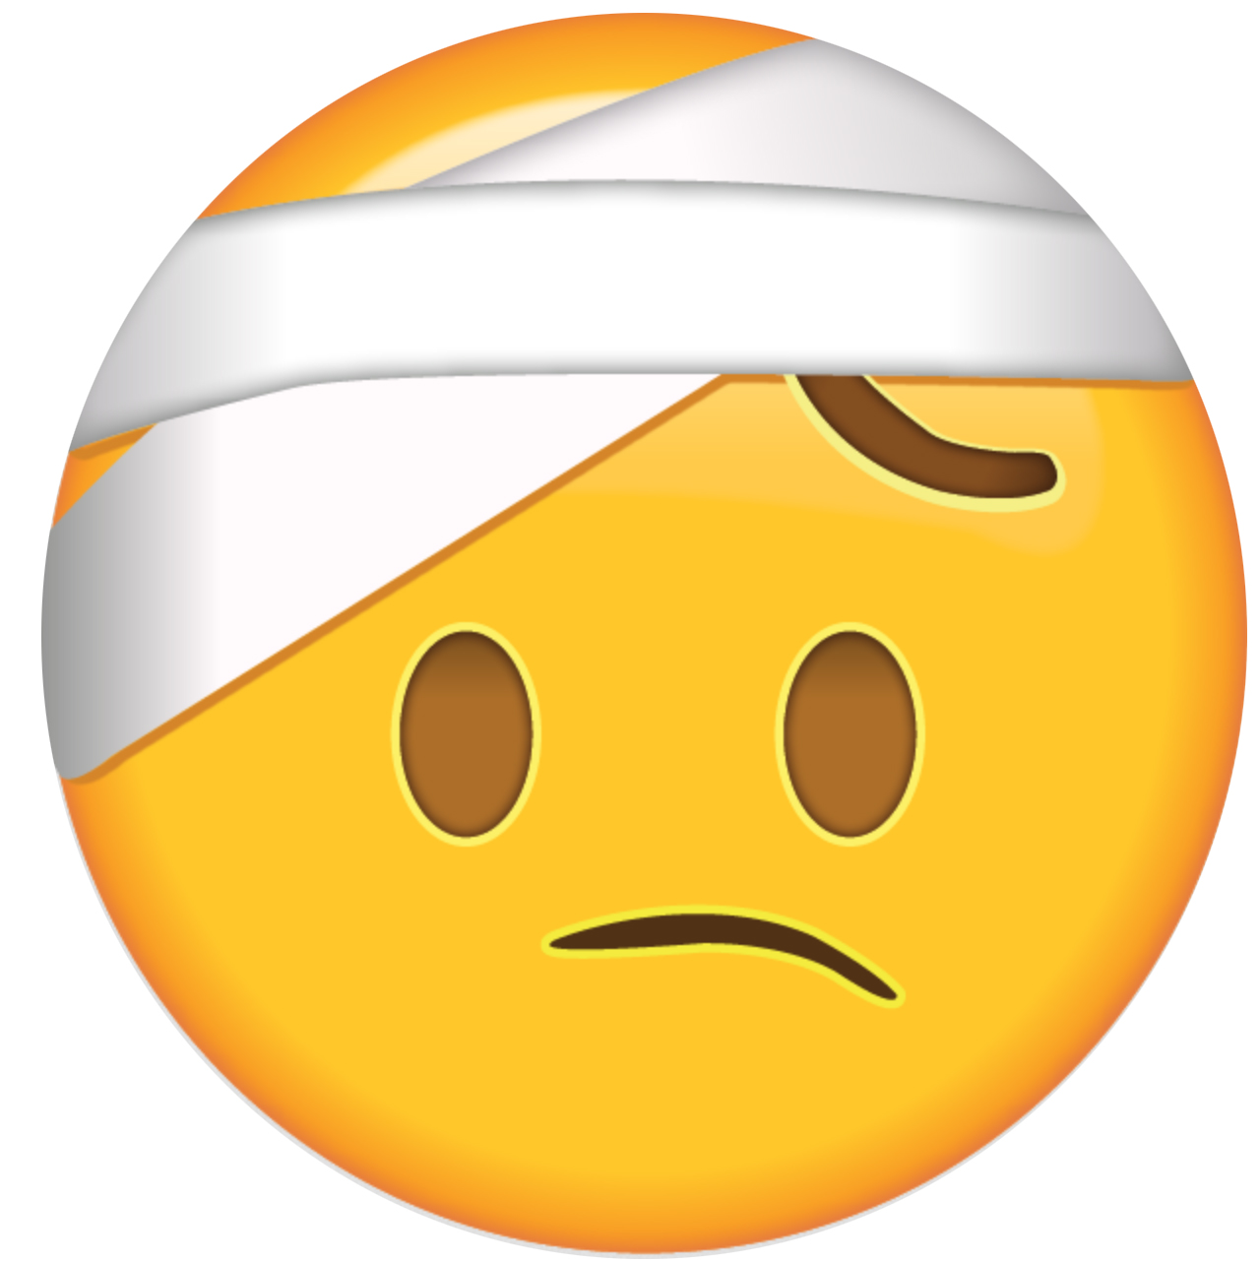
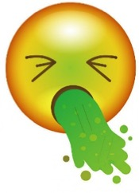
How much is too much for adults?
If someone drinks a lot
have an accident
Their reactions slow down
get involved in a fight
get involved in other danger
They might also
be sick or pass out
Notes:
For healthy adults doctors say 14 units per week is OK, but this should be spread over a number of days rather than consumed in binges.
Make it clear that talk of drinks and guidelines are for adults over the age of 18 and not young people, as alcohol has a greater effect on the brain and organs of young people, making them more likely to do risky things, be sick or unwell.
If someone drinks a lot reactions slow down, they may be sick, pass out, have an accident, get involved in a fight or dangerous things

Slide 10
Alcohol and the Law
Notes:
Work through the Alcohol and the Law sheet.
Participants should understand that it is illegal to buy or be served alcohol in licensed premises (pub, nighclub, shop) or in a public place when underage.
A parent may or may not allow small amounts of alcohol in the home for those younger than 18, this is not against the law and it is a parental/carer decision.
Strangers/friends/other adults who offer to buy or give you alcohol to those under 18 are breaking the law. This is called buying by proxy.

Slide 11
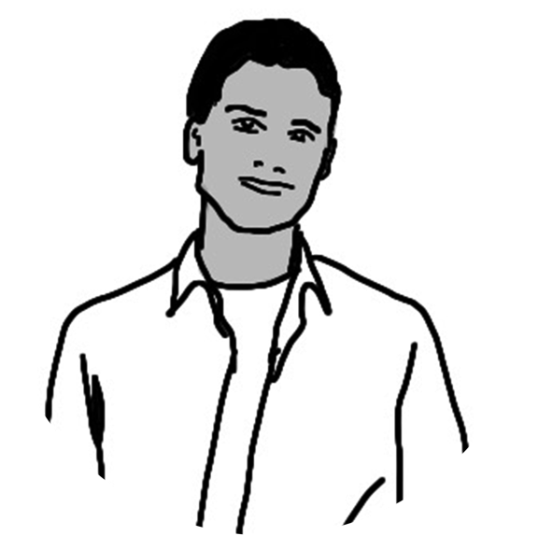
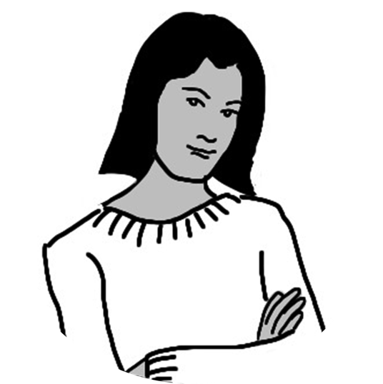
Mike Emma
Using characters

Slide 12
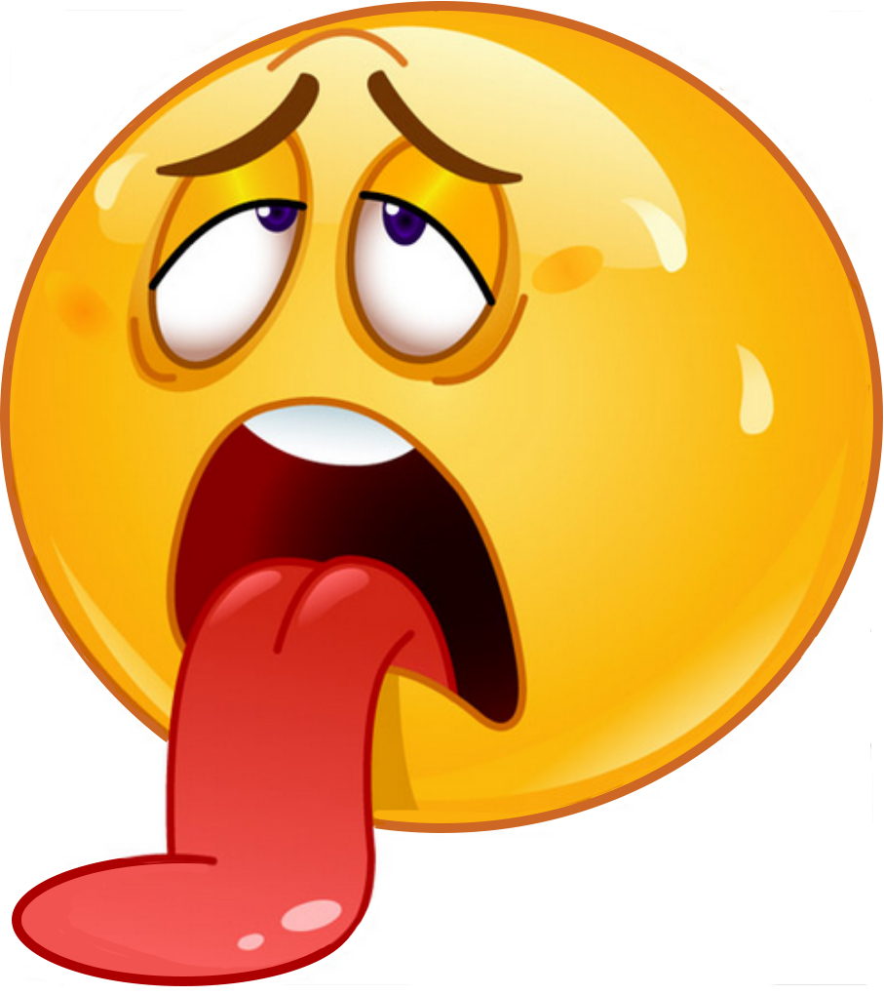
Alcohol and the body
Alcohol and the body
When people drink alcohol, it affects how they feel, act and behave.
After a little alcohol and someone may feel relaxed and happy.
or
After one or two drinks it can affect a person’s health and different parts of their body too.
or

Slide 13
Alcohol and the body
Alcohol and the body

Slide 14
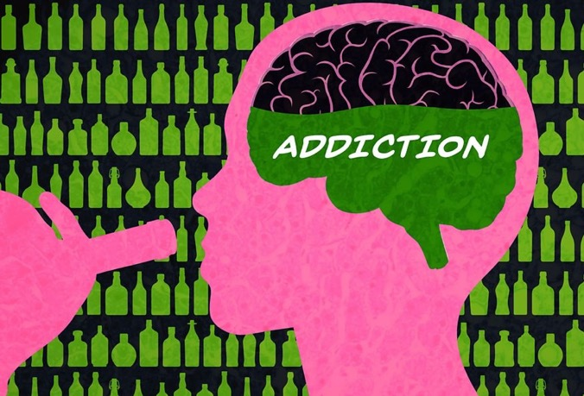
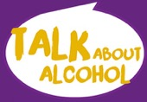
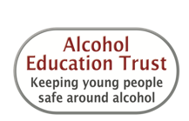
Alcohol and addiction
3% of adults are classed as dependent drinkers or alcoholics.
Signs of addiction:
Frequently drinking to stage of passing out
Drinking on own or secretly
Feeling unable to get through a day without alcohol
Feeling unable to stop drinking once started
having tremors and shakes without alcohol
Notes:
Some people think that drinking alcohol helps relieve stress and anxiety and so problems will be forgotten for a while.
Sadly those problems are still there when sober and could be made worse by spending money on alcohol or due to the headache and hangover suffered after drinking too much.
Other people think feel that alcohol makes them more confident and happy and so they can slip into harmful patterns of drinking. – drinking more often and more each time. That’s why it’s important to be aware of the low risk guidelines of drinking 14 units ( 7 pints or glasses of wine or 7 double vodkas) each week or less and spread over the week.
If someone begins to notice they are drinking significantly more than this, are drinking secretly, or feel they can’t stop drinking or need a drink in the morning – then the earlier help is looked for the better. There are local groups of people who meet each week to fight their alcohol addiction or the doctor can refer to the best support groups and organisations in the local area.
There are also organisations that support the family and children of alcoholics and a full list can be found on the: where to go for help and support list

Slide 15
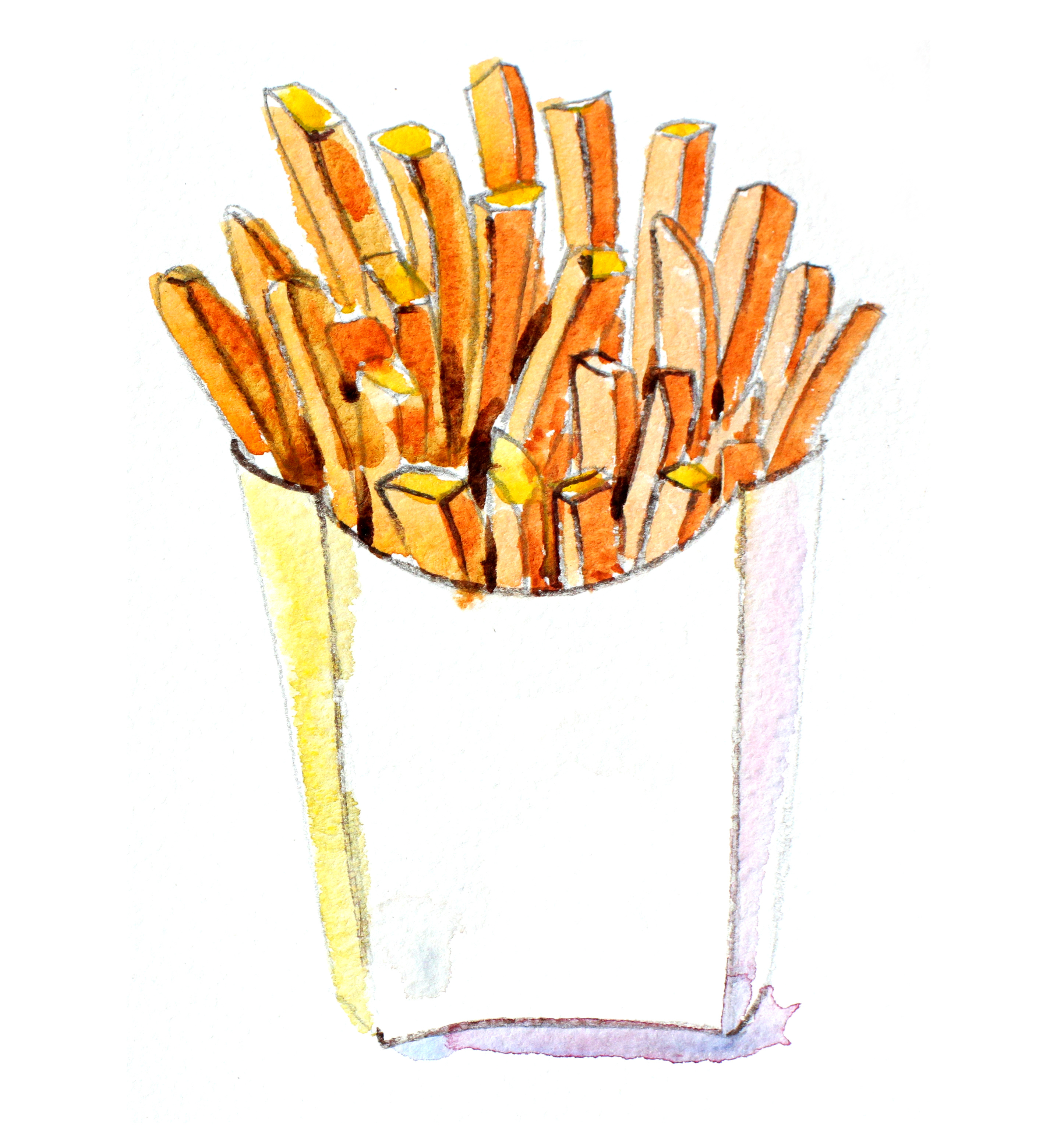
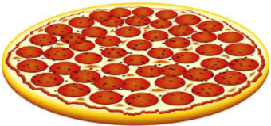
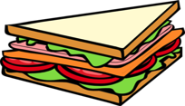
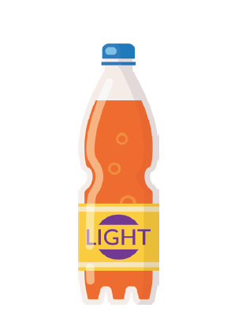
Drinking water and eating with alcohol
It is better to eat before or while drinking.
Drinking plenty of water or soft drinks keeps people hydrated and in control.
It saves money too!
Notes:
^{Explain the importance of}
- pacing (drinking soft drinks to slow down drinking) and
- eating before or while drinking as this slows down the absorption of alcohol into the body
Explain the importance of eating before or while drinking as this slows down the absorption of alcohol into the body.
Pacing (alternating alcoholic drinks with soft drinks to slow limit consumption) also stops someone from drink a large quantity of alcohol too quickly

Slide 16
Alcohol and the brain
Brain
+
+
water or eating 1 or 2 happy
soft drink alcohol drinks
drink too
much
upset or anxious or angry
leading to accidents, fights or injury and hangover the next day
Notes:
Brain
Too much alcohol acts a depressant on the brain, the control centre of the body. It can make the drinker feel happy for a little while, but that’s followed by a depressing low. Long-term drinking can kill off brain cells and lead to memory loss and mental problems

Slide 17
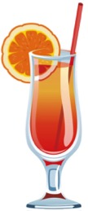
Alcohol and the heart
Heart
+
+
food
content
and relaxed
water or
soft drink
one alcoholic drink
Drink too much alcohol or
drink too fast
heart beats fast
panic attacks
and sweating
Notes:
HEART
Drinking large quantities of alcohol over a short period can cause irregular heart beats and shortness of breath, leading to panic attacks and illness. If an adults drinks one or two drinks, it’s fine, but it’s important to be physically active, eat a healthy, balanced diet and to avoid smoking if you want to be ‘heart healthy’

Slide 18
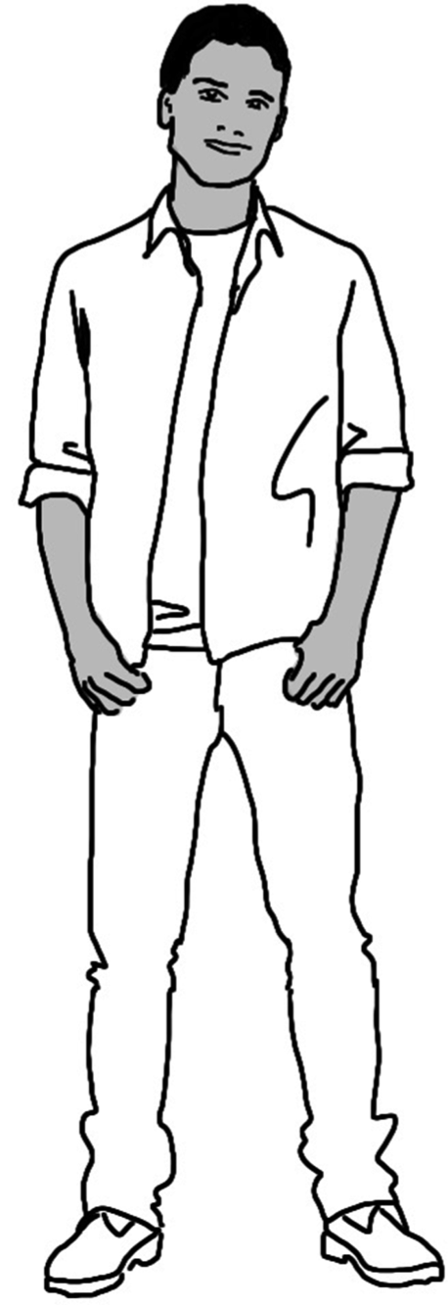
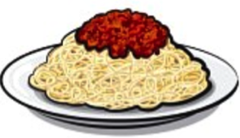
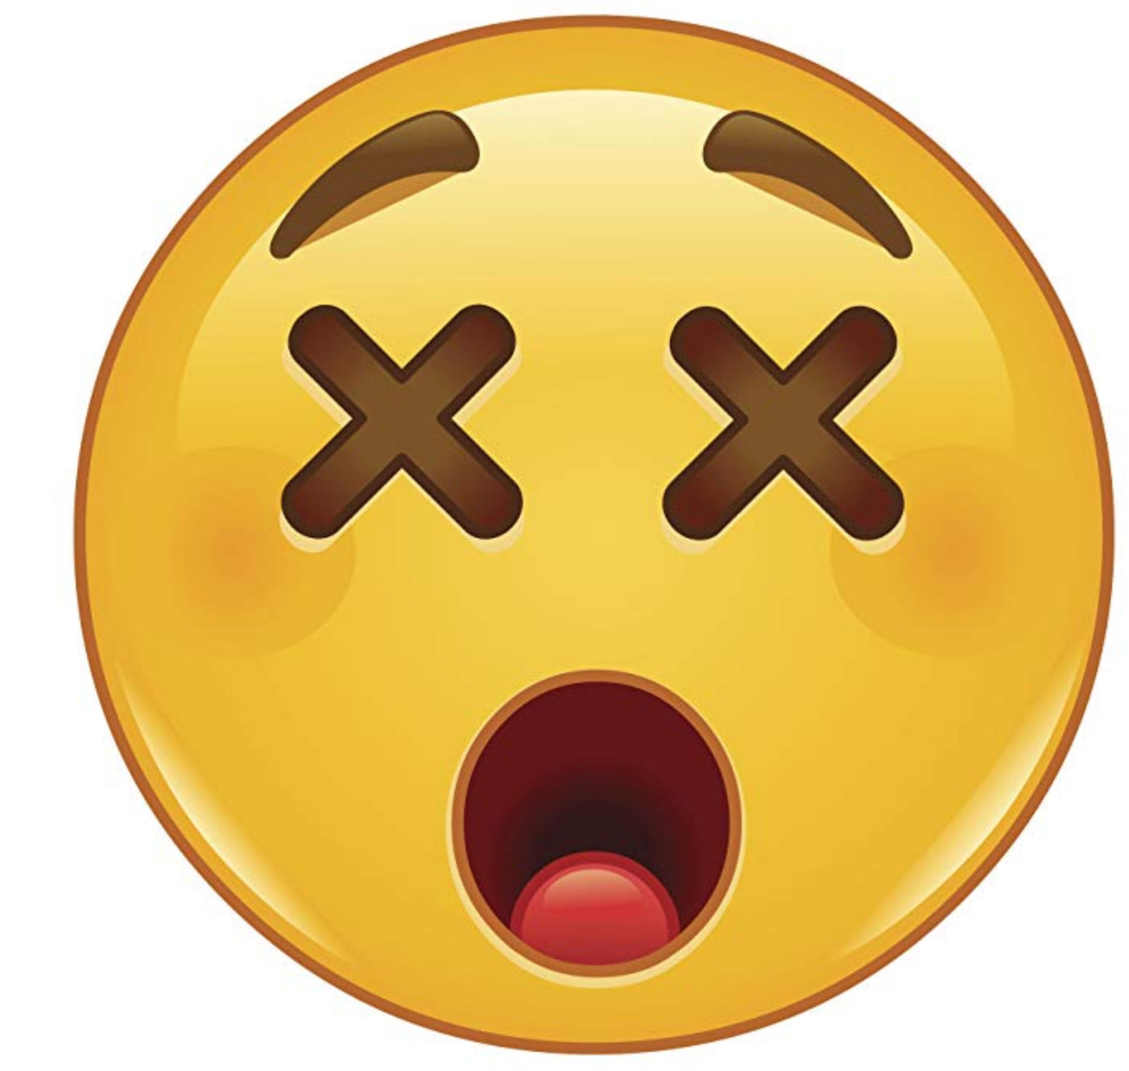
Alcohol and sex
+
+
eating water or 1 or 2 alcohol content
soft drink drinks
drink too much
risky sex and not able to give consent
Notes:
PRIVATE PARTS
Drinking too much alcohol can affect performance in the bedroom because the drinker’s not fully in control of their body. Alcohol affects judgement too, so people may have unsafe sex or sex they later regret, which could lead to pregnancy or STIs. In women, heavy drinking may delay periods and affect fertility. As alcohol crosses the placenta to the baby, you should not drink if you are pregnant.

Slide 19
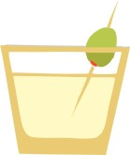
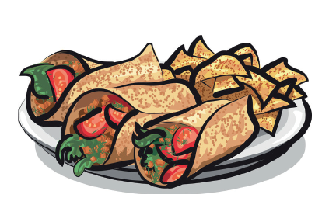
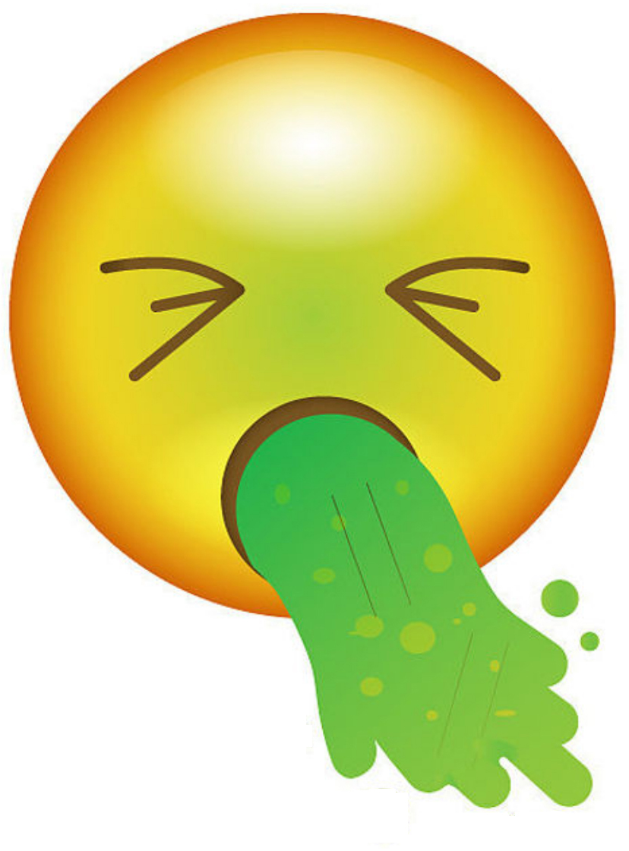
Alcohol and the liver
Liver
+
+
eating water or 1 or 2 happy
soft drink alcohol drinks
drinking too much
sick and unwell liver damage

Slide 20
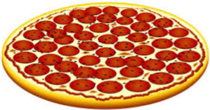
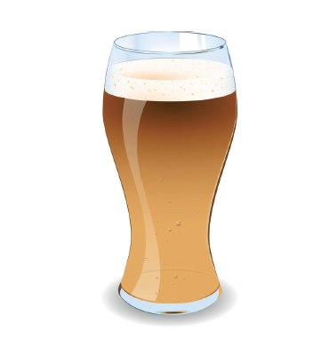
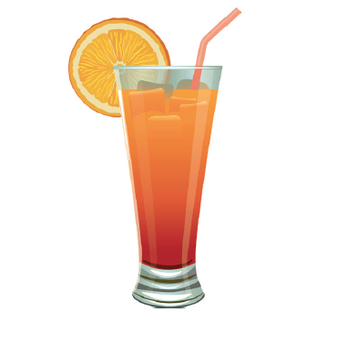
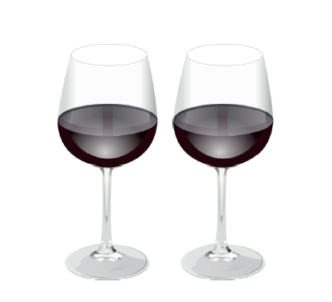
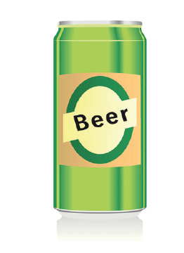
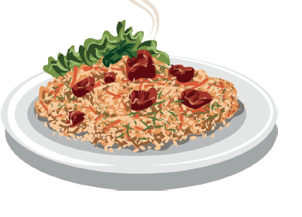
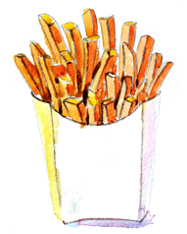
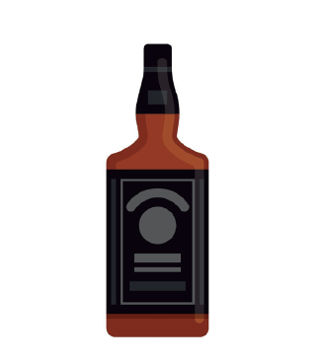
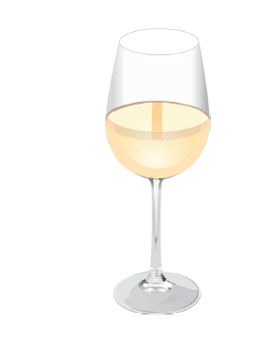
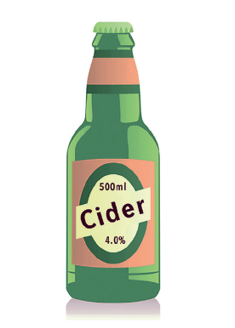
Have a go at making your own
emoji equations
+
=
=
+
Notes:
Put in lots of different icons here with arrows, equals, happy and sad and sick faces, unwell, sexy, all different drinks and soft drinks, food, dancing, etc – good and bad options. Include law ones, injury if possible?

Slide 21
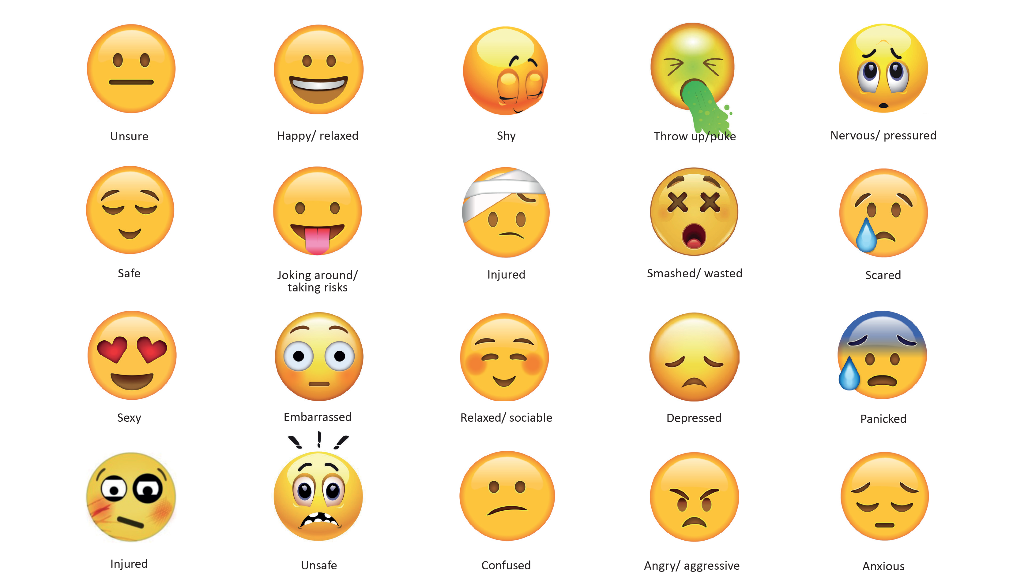
Have a go at making your own
emoji equations
Notes:
unsafe
sexy
embarrassed
joking around/ taking risks
nervous/ pressured
happy/ relaxed
unsure
safe
shy
Angry/ aggressive
panicked
scared
anxious
depressed
injured

Slide 22
Safe and unsafe ways to try alcohol
In pairs think of examples of safe and unsafe ways to try alcohol
Where?
How strong?
What age?
Who with?
How much?
Other food
and drink?
safe
unsafe
At home with family as part of a celebration
In a park with a new friend

Slide 23
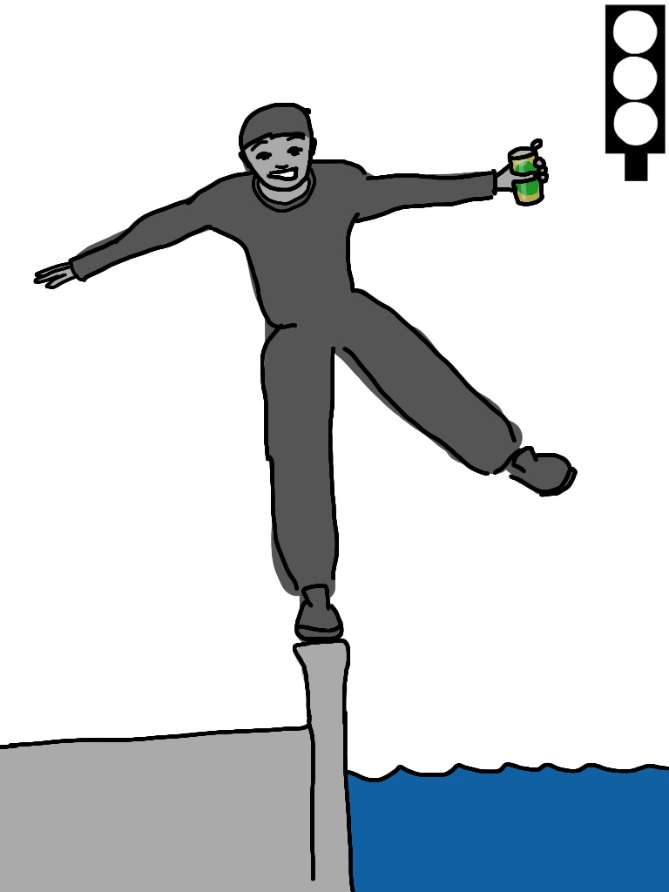
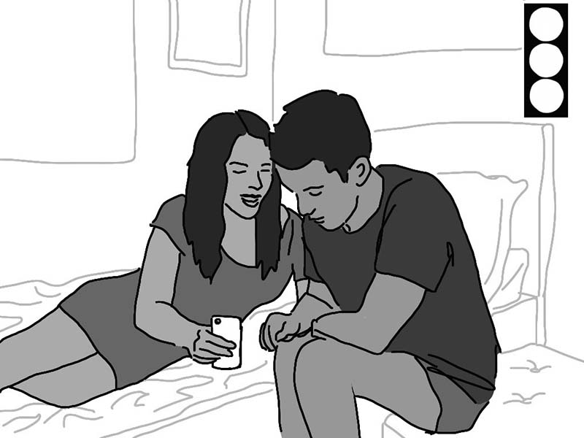
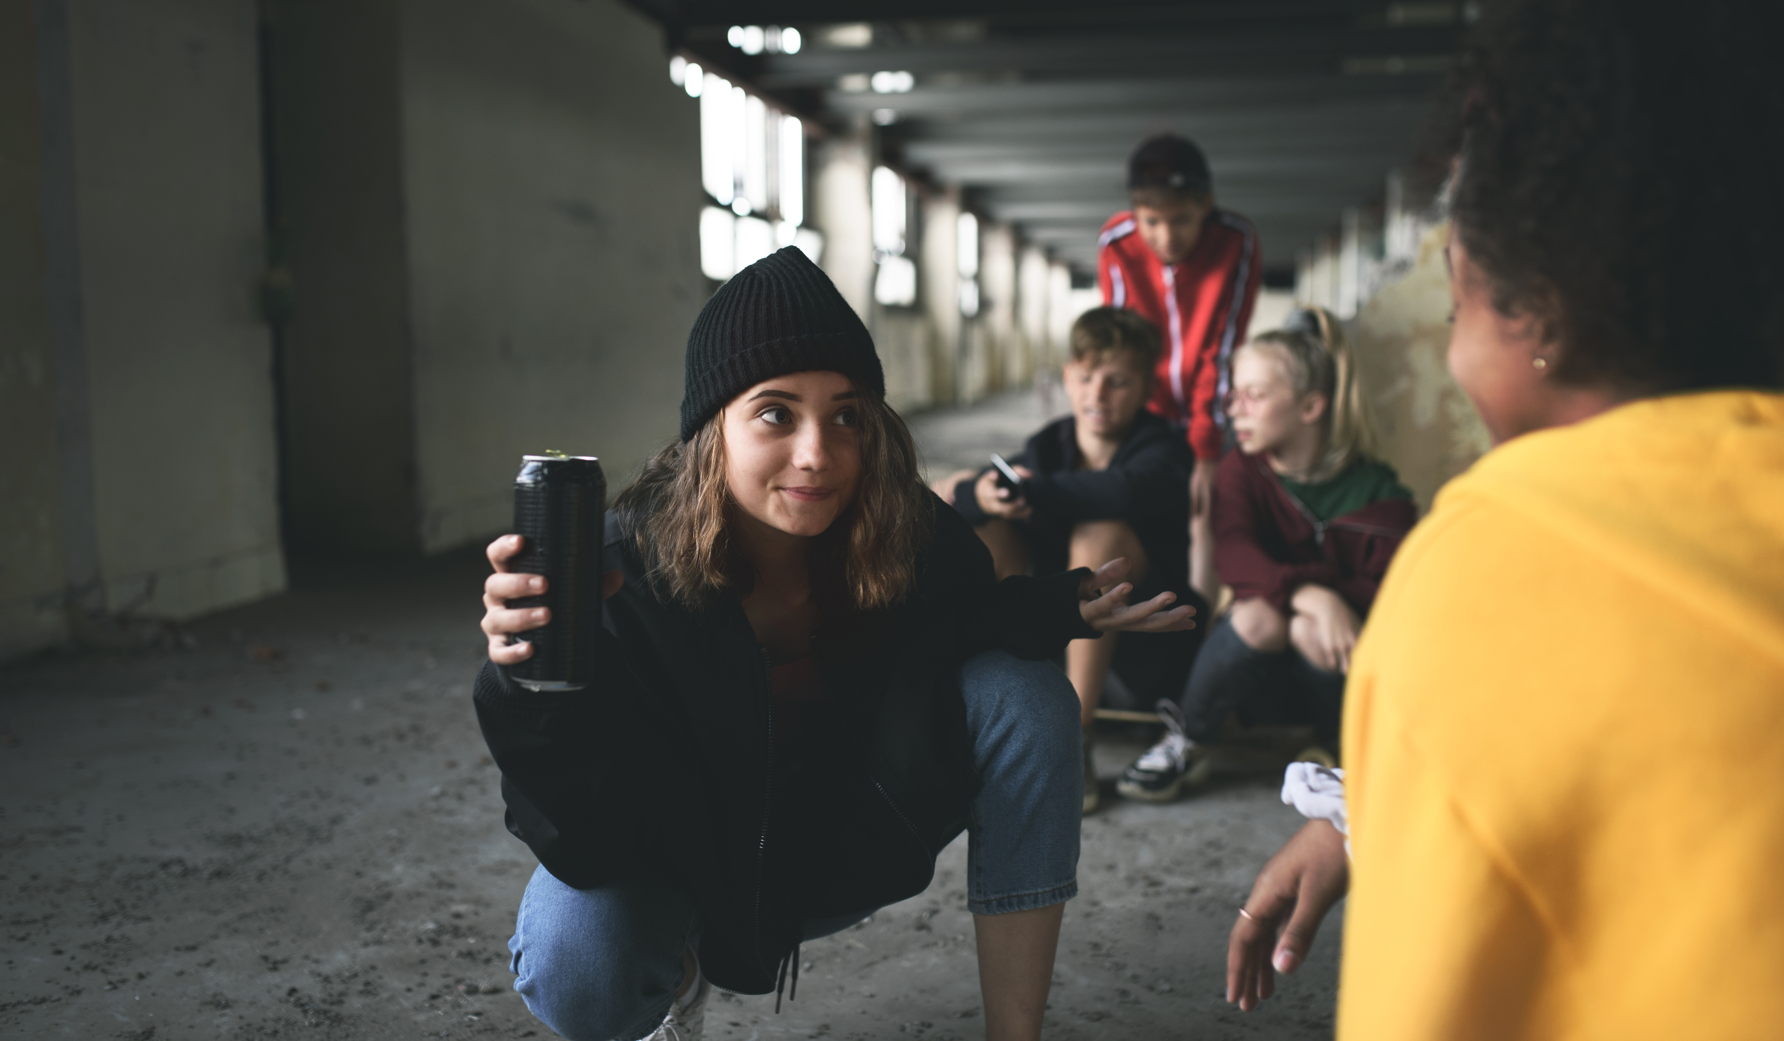
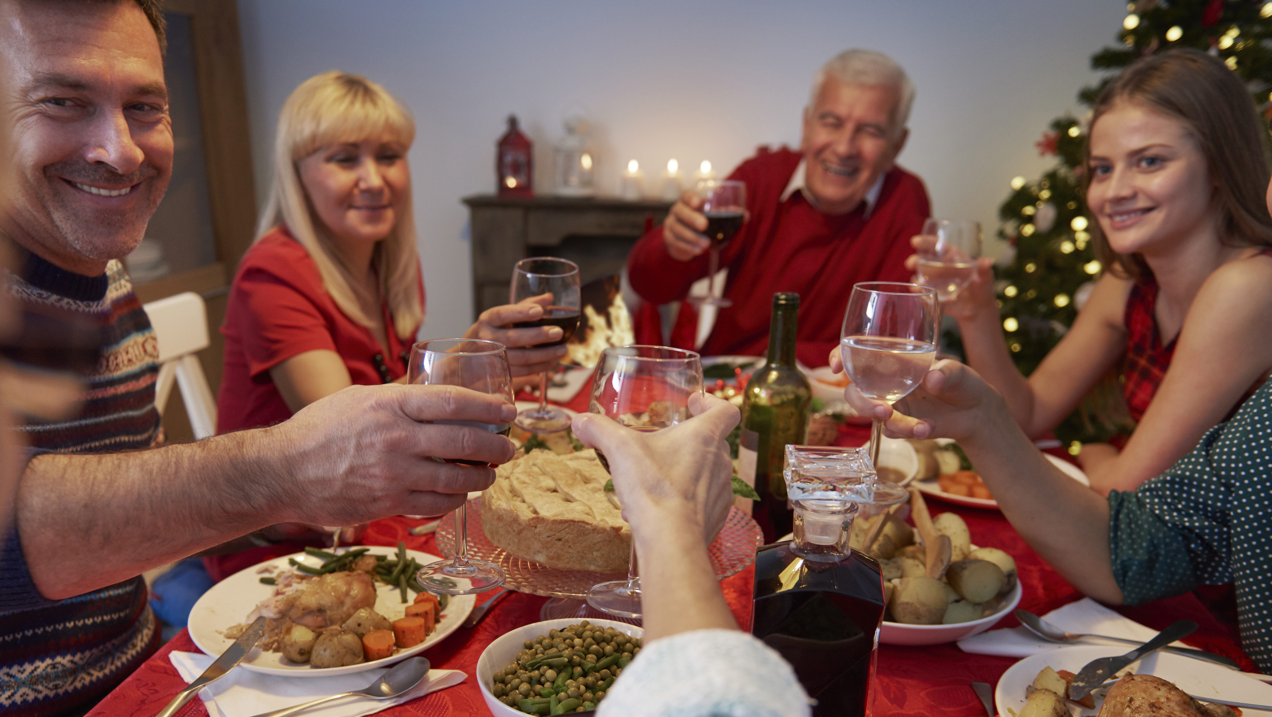
Safe and unsafe ways to try alcohol
Use the pictures to think about safe and unsafe ways to try alcohol.
Notes:
use the pictures to think about safe and unsafe ways of drinking alcohol, how much, who you are with, how quickly you drink

Slide 24
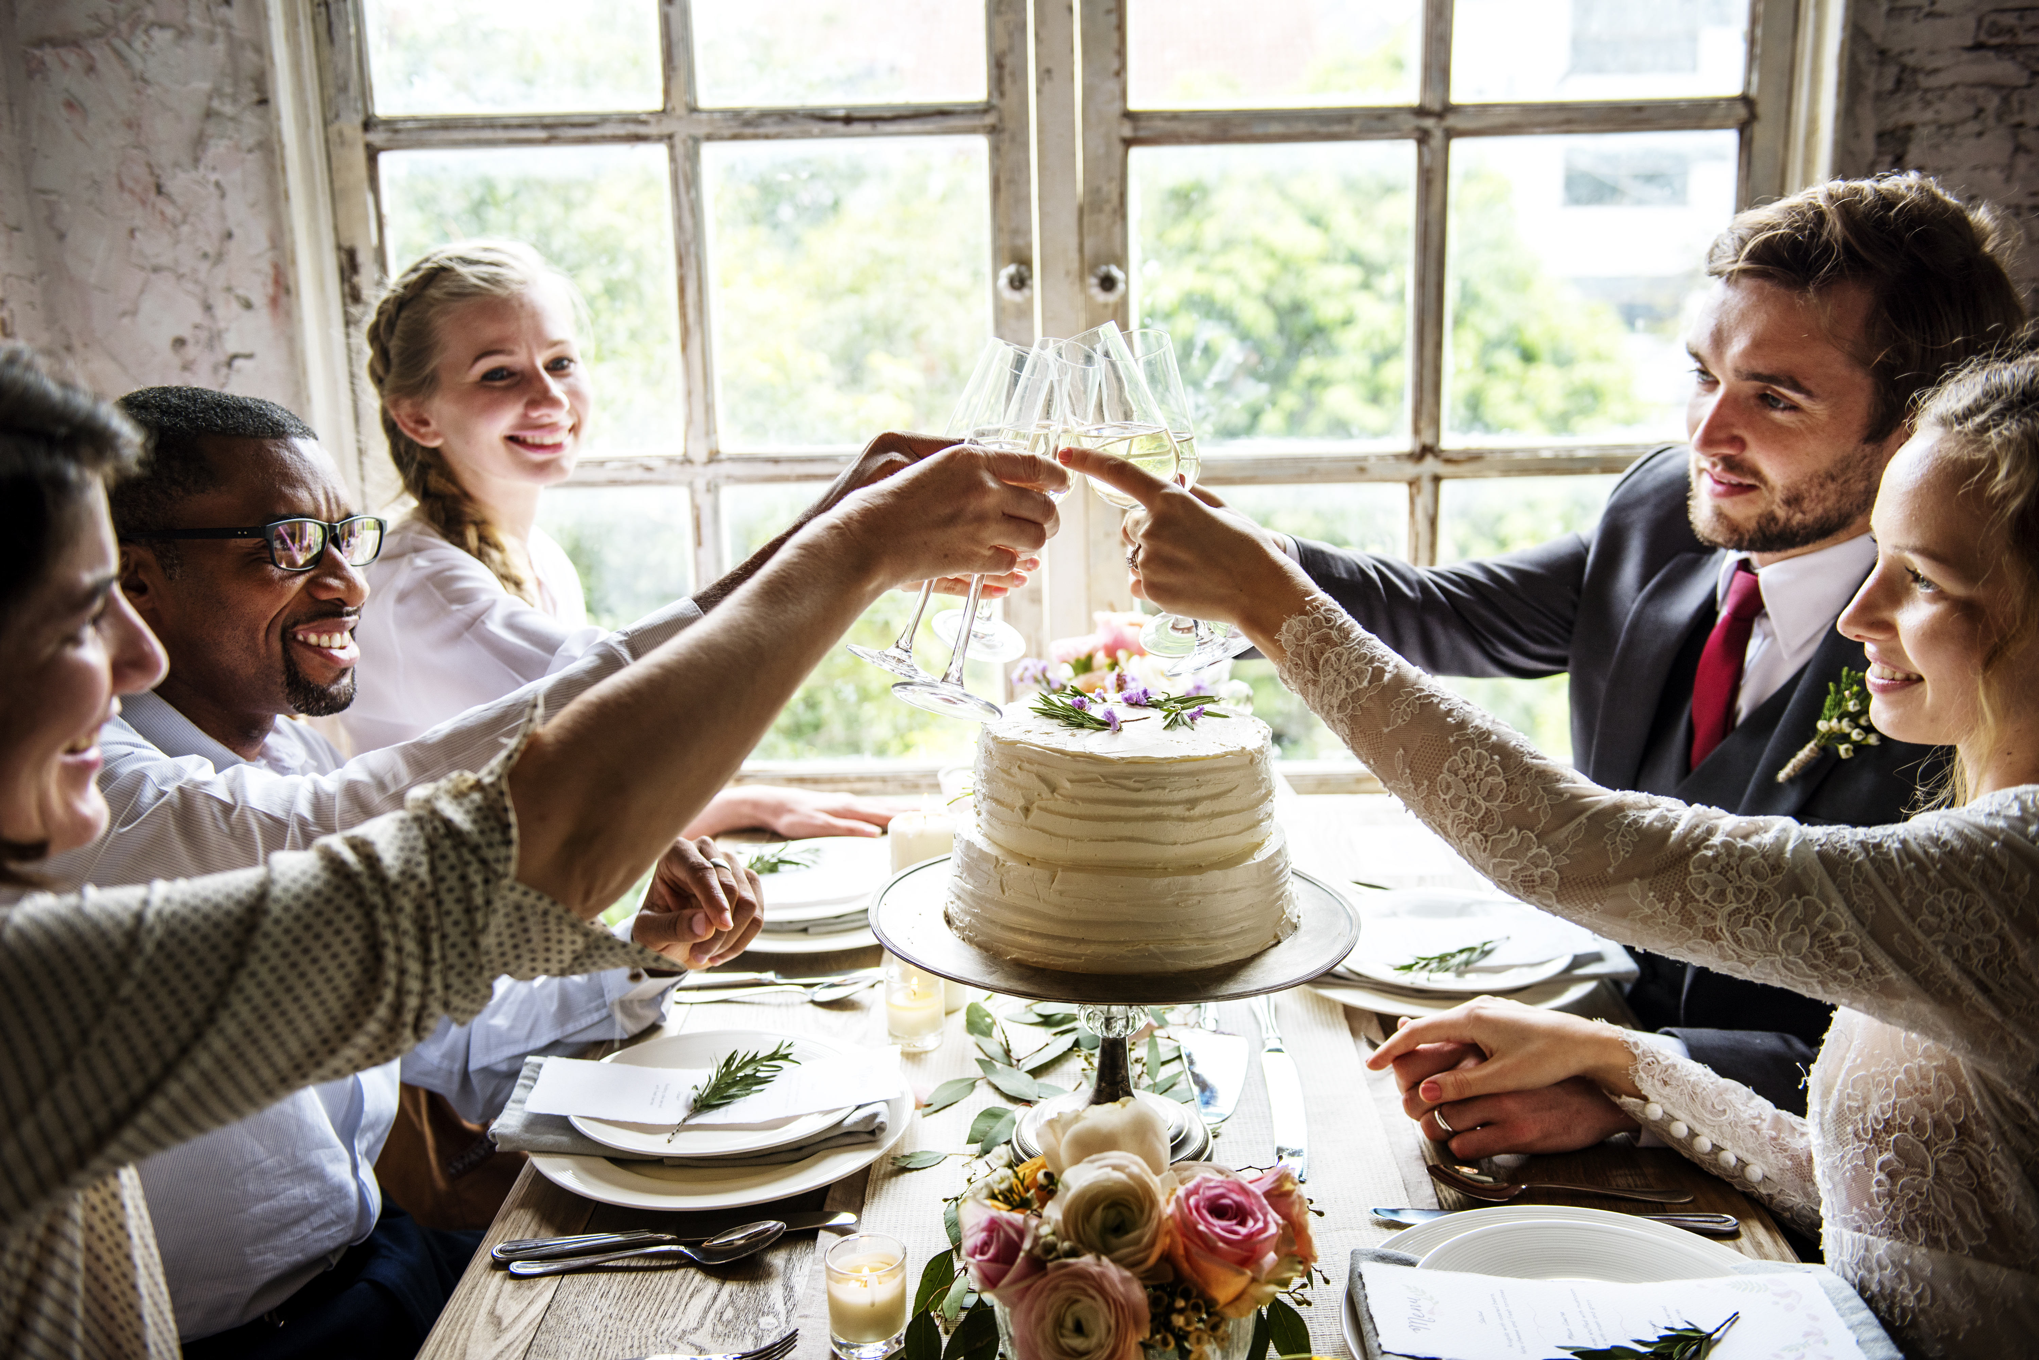
Safe and unsafe ways to try alcohol
Use the pictures to think about safe and unsafe ways to try alcohol
Notes:
use the pictures to think about safe and unsafe ways of drinking alcohol, how much, who you are with, how quickly you drink

Slide 25
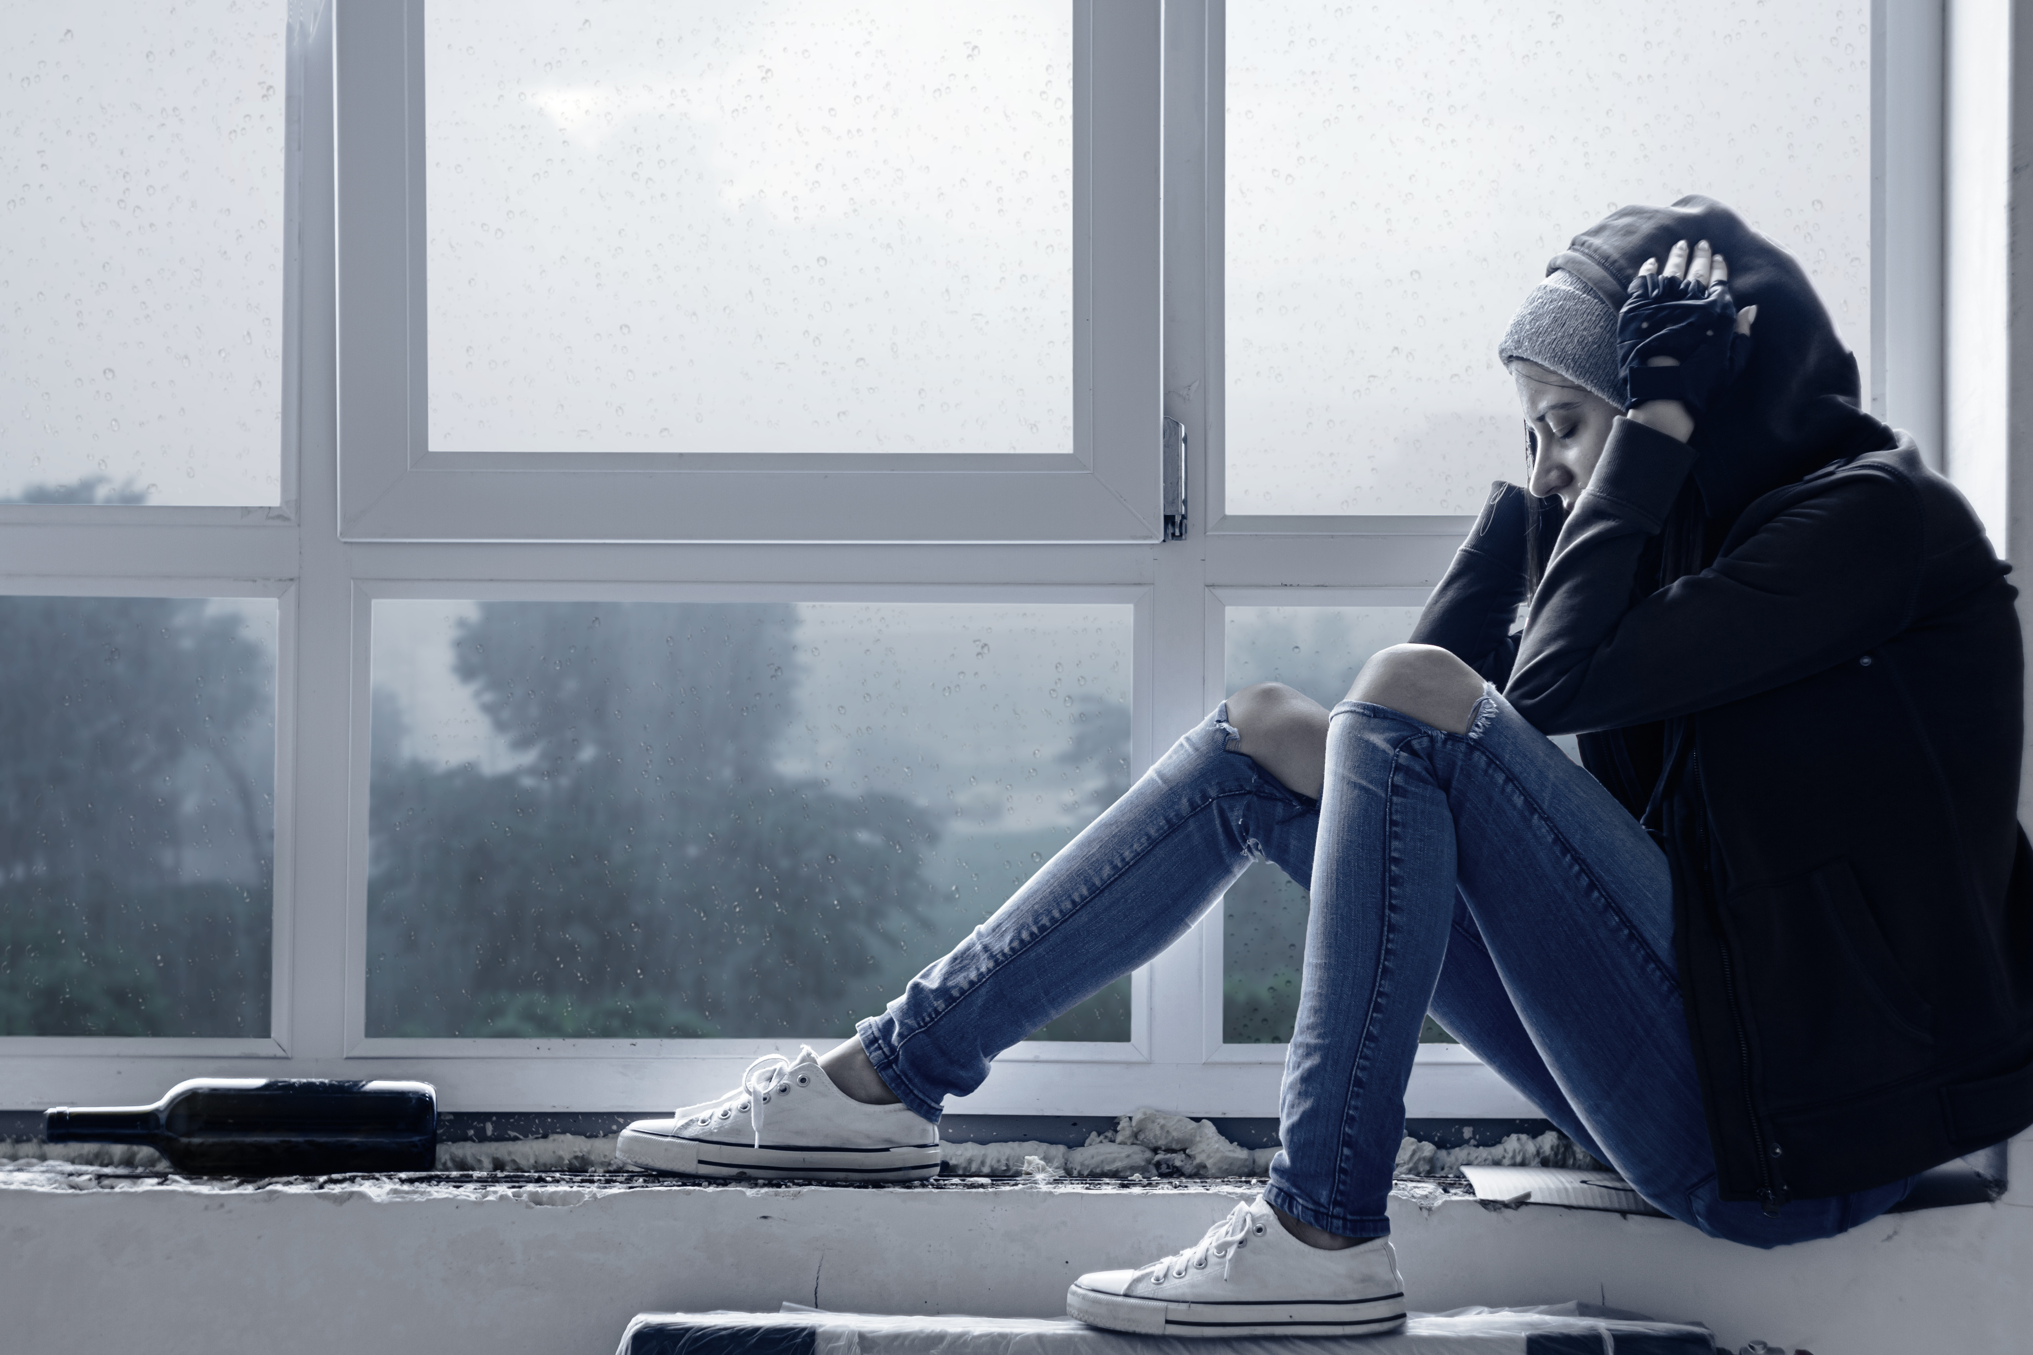
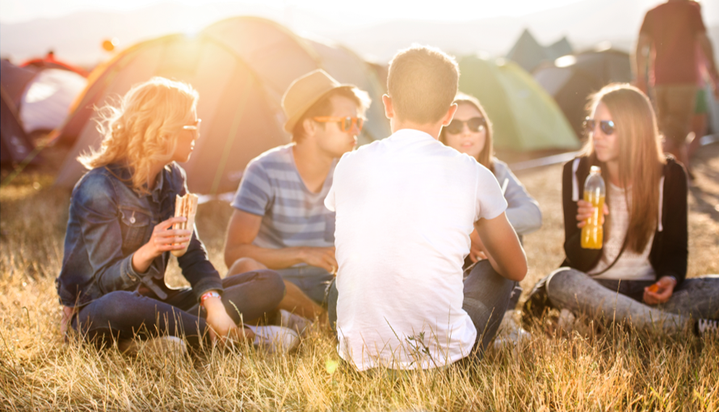
Safe and unsafe ways to try alcohol
Use the pictures to think about safe and unsafe ways to try alcohol.
Notes:
use the pictures to think about safe and unsafe ways of drinking alcohol, how much, who you are with, how quickly you drink

Slide 26
What have we covered today?
We have discovered what a unit of alcohol is.
We have learnt how different strength and size drinks may contain different amounts of alcohol.
We have looked at laws for buying and drinking alcohol.
We have explored how drinking alcohol may affect someone's health and their safety.

Slide 27
What can you remember?
CAN YOU……
Give examples of 2 different drinks and the number of units in them?
Give two examples of when adults shouldn’t drink?
How old must someone be to buy alcohol in a shop, pub or restaurant?
Is it legal for an adult to buy alcohol for someone who is underage?
Give two examples of situations where it would be unsafe to try alcohol.

Slide 28
Talk about alcohol Foundation learning

