Slide 1
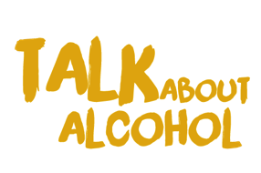

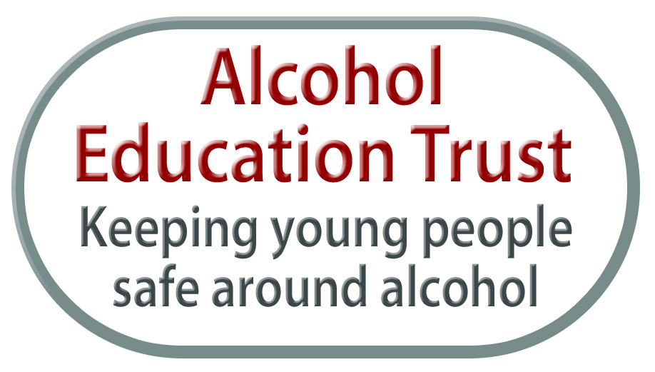
Talk about alcohol
Emotions AND FEELINGS

Slide 2
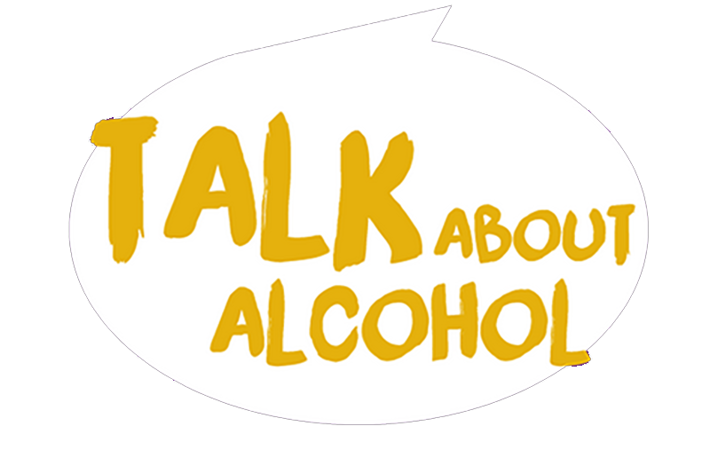
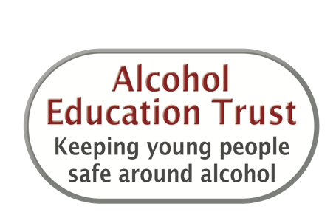
Learning objectives
We will
Consider how alcohol affects a person’s feelings, behaviour and decision making.
Explore factors that might make drinking alcohol more risky.
Discover how much and how often other people drink alcohol.
Learn how the amount a person drinks will affect their risk of harm.

Slide 3
Intended learning outcomes
I will be able to
Identify situations where alcohol consumption is likely to lead to harm.
Explain which outcomes are more likely depending on how much alcohol someone has consumed (versus heavy alcohol consumption).
Outline ways that someone can reduce the risk of alcohol-related harms.

Slide 4
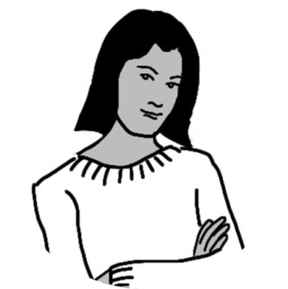
Emma is feeling upset and angry
How alcohol can change how someone feels
Emma has had an argument with her mum.
What happens to her body when she feels like this?

Slide 5




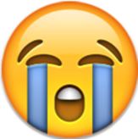

How alcohol can change how someone feels
SUPER EXCITED/ BUZZING
HAPPY
OK
SAD
UPSET
ANGRY

Slide 6
Alcohol can make you feel like this too!
How alcohol can change how someone feels

Slide 7
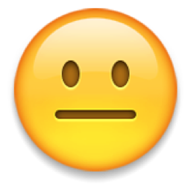



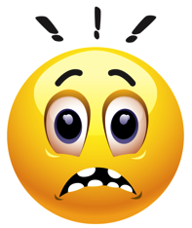

How alcohol can change how someone feels
These faces can help you show how someone may react around alcohol
Feeling OK
Feeling relaxed
Feeling content
Joking around
Nervous or pressured
Worried

Slide 8

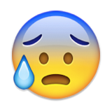

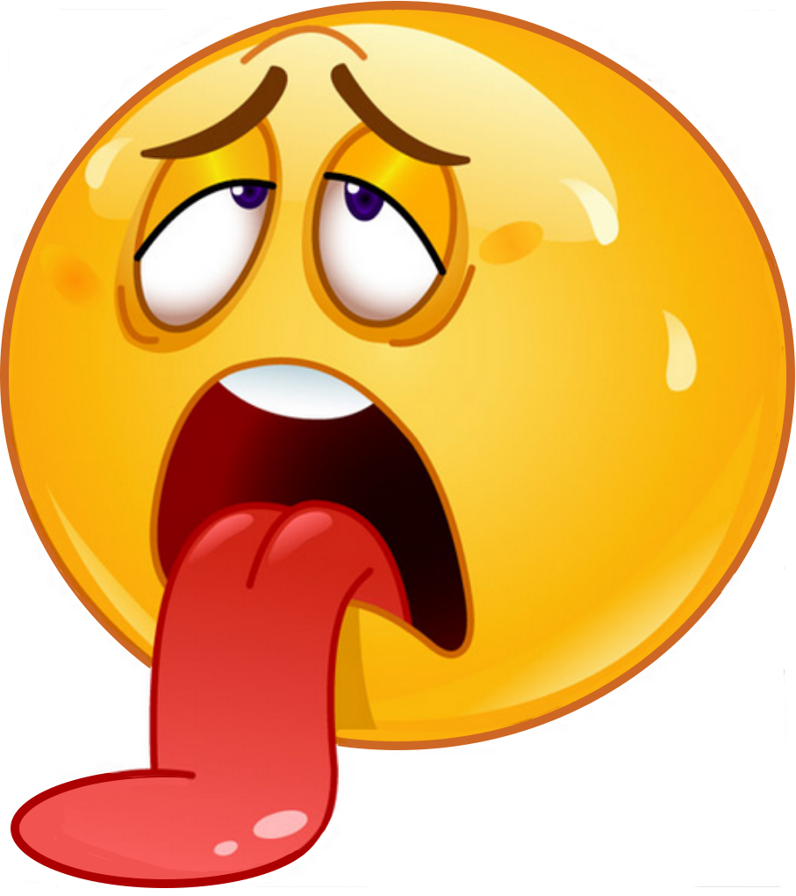
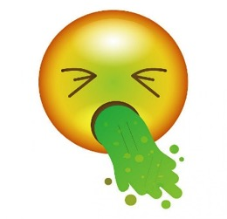
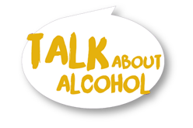
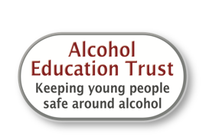
How alcohol can change how someone feels
Panicky or scared
Feeling ill
Shy
Feeling sexy
Feeling sick

Slide 9
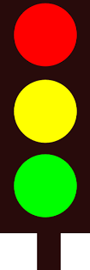


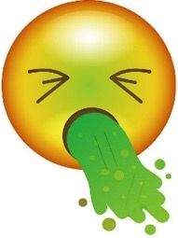
The traffic light can help us stop and think before we act!
Stop! NO | Don’t rush. Say ‘No’ if you’re not happy
When we make the wrong decisions

Slide 10
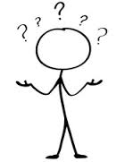

The traffic light can help us stop and think before we act!
When we are unsure
Think and decide | Is it safe? Yes or No?

Slide 11


The traffic light can help us stop and think before we act!
When we make safe decisions
OK, YES! | If you’re happy and sure you’ve thought the decision through

Slide 12
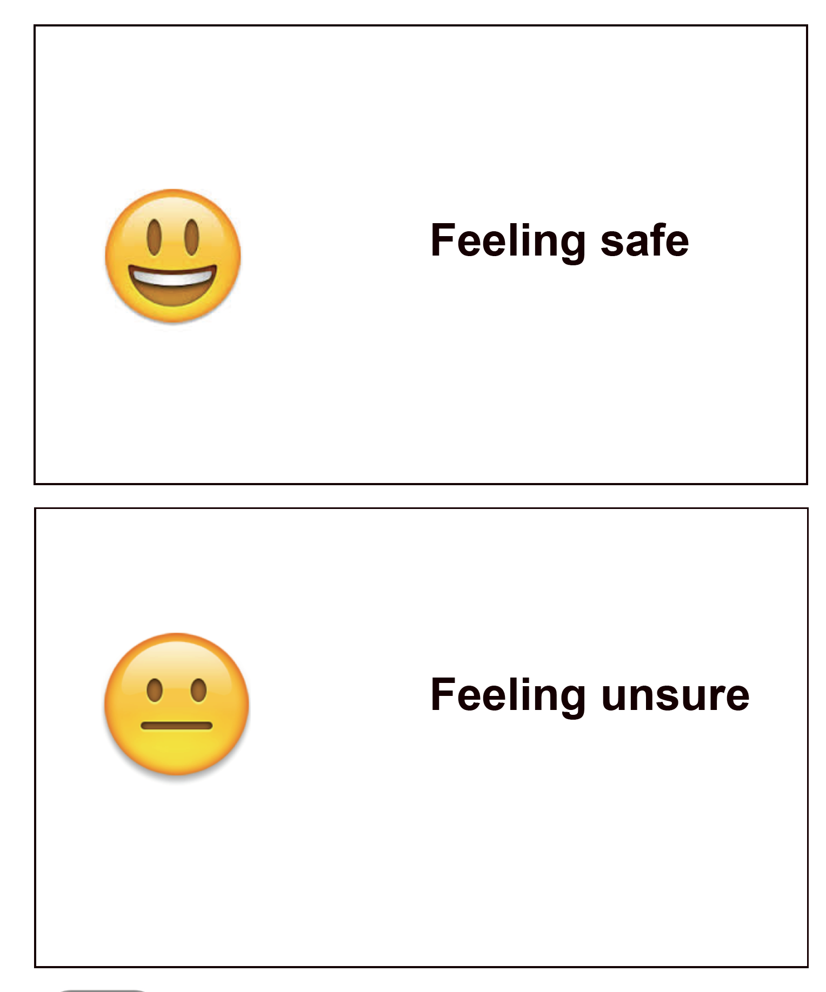
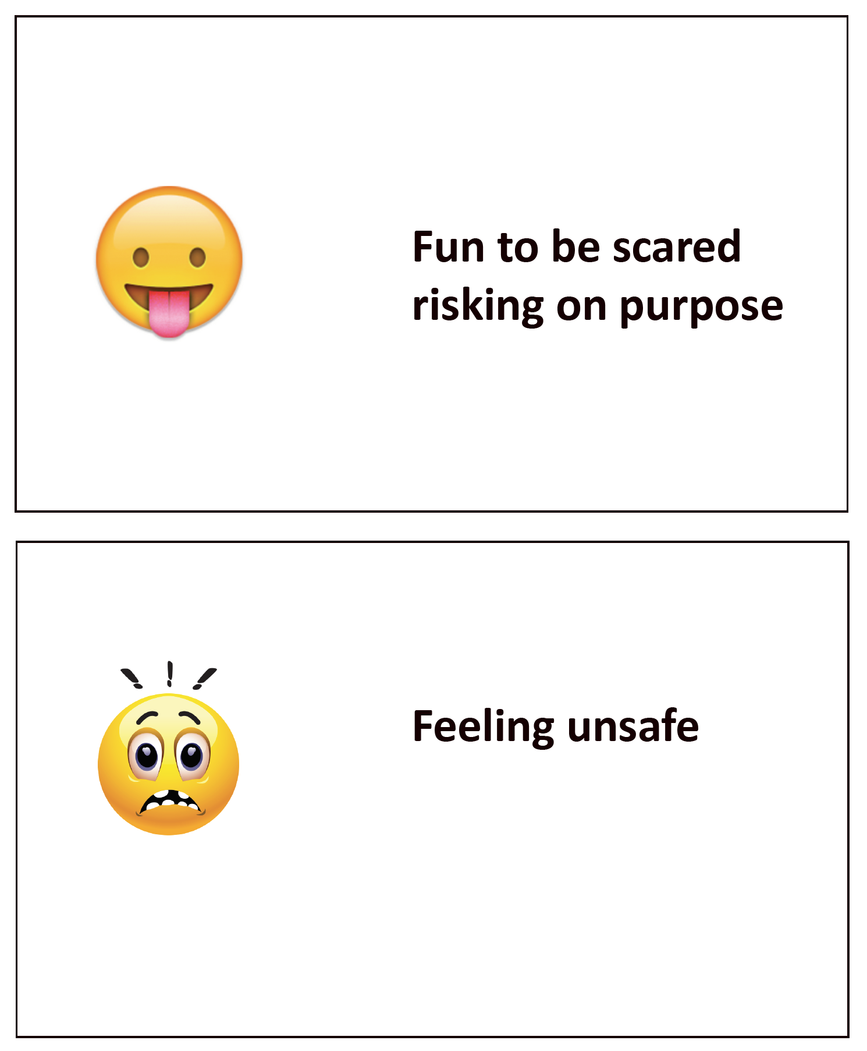
Risk Scale
Notes:
Example statements that students can place on the risk scale
You may also choose to use the traffic lights or emoji characters with this activity, and to continue to use the characters Mike and Emma.
Drink an alcoholic drink at a family party at 17.
Drink alcohol at a friend’s house without their parents knowing.
accept an alcoholic drink bought by an older person when aged 15.
Down drinks in a dare competition with some mates.
Throw up from drinking too much alcohol.
Drink in a public place, such as a park, when aged 16.
Buy ID from an older mate who looks quite similar.
Ask someone over 18 to buy alcohol to drink at a party when underage.
Put alcohol into someone’s soft drink as a joke.
To have sex with someone aged 18 when they are drunk.
To go out drinking without eating first
To alternate soft drinks with alcoholic drinks when going out clubbing (when aged 18)
To drive the morning after a big night out
To feel anxious about drinking.
To tease someone for not drinking.
To feel not ready for alcohol.
To drink cans of alcohol bought by others out of a sense of duty and loyalty.
To feel sick from drinking alcohol.
To try to stop someone from drinking too much.
To have a drink of alcohol with a meal at 16, when out with parents.
Make up funny stories about someone getting drunk under age.
To have not tried alcohol at all at 18.
To have tried alcohol and not liked it.
16 year old to have one drink of alcohol at a party.
Worry about how to drink without getting too drunk and embarrassing yourself.
To hit a boyfriend or girlfriend when drunk.
To have sex when you are drunk or with someone who is drunk.
Kiss someone for a dare when you have had alcoholic drink.
To go to a quiet area of the park with a partner where no one can see and drink.

Slide 13
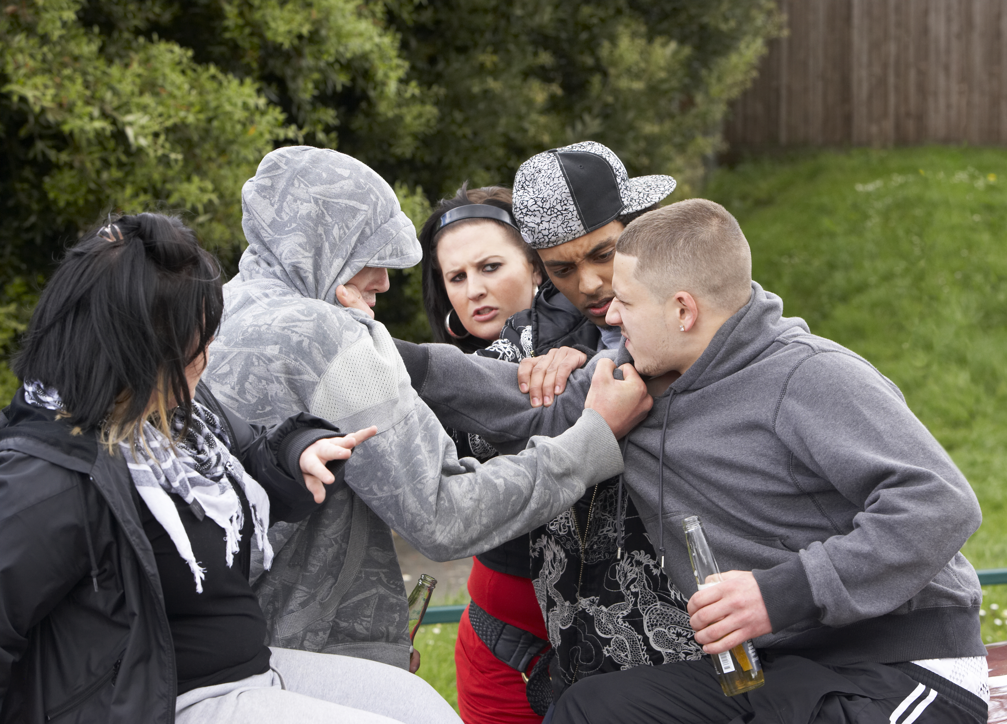
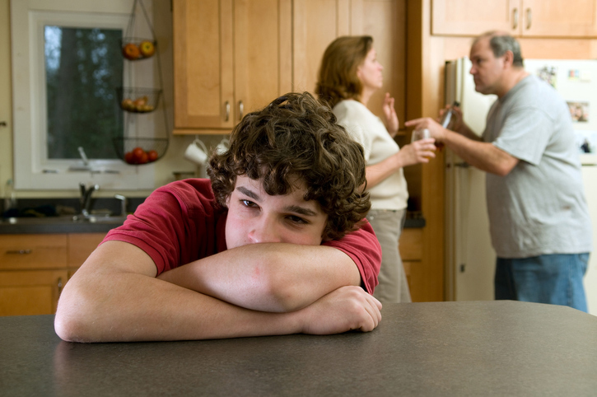
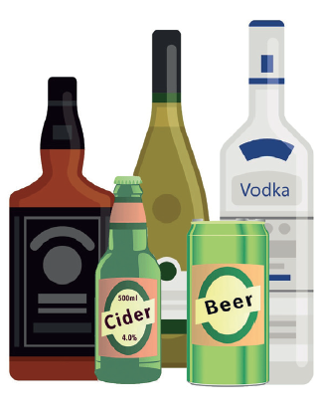
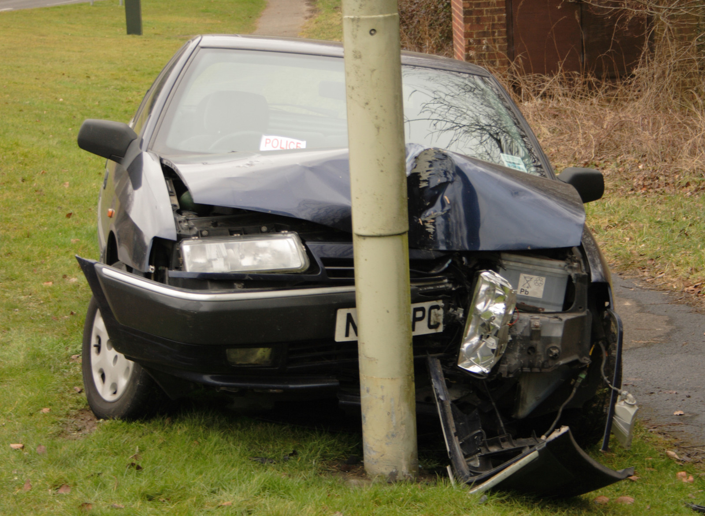
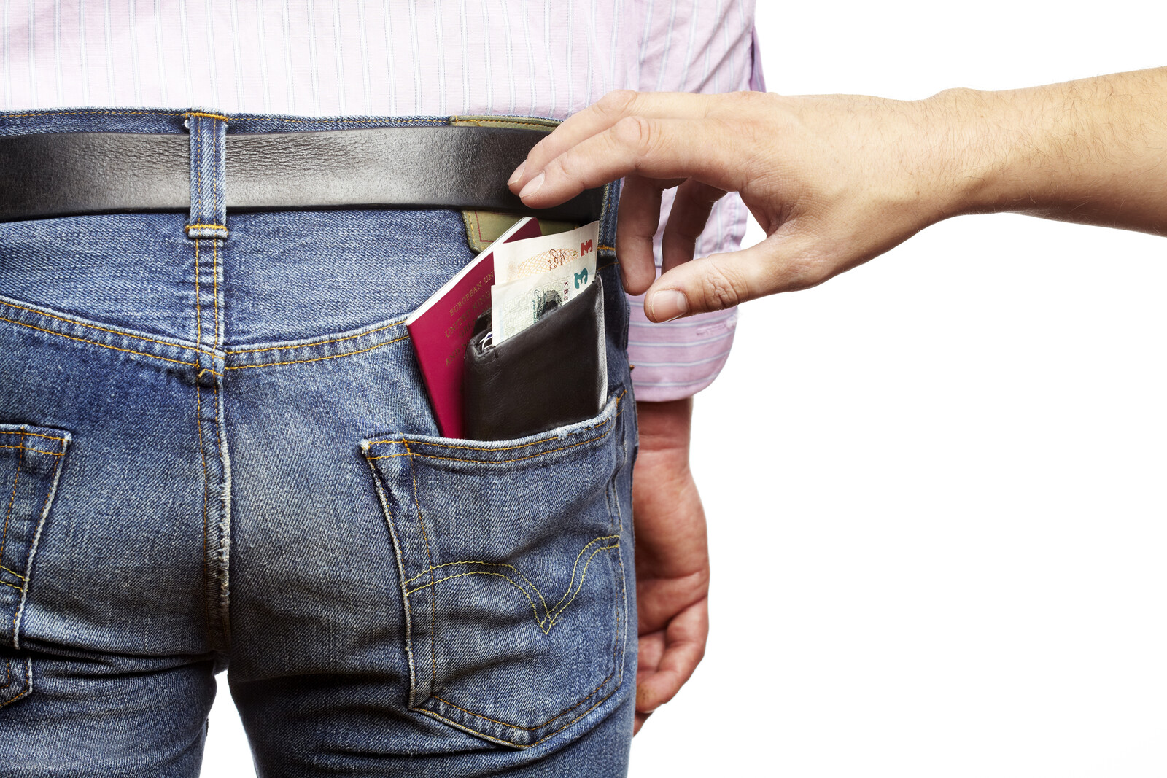
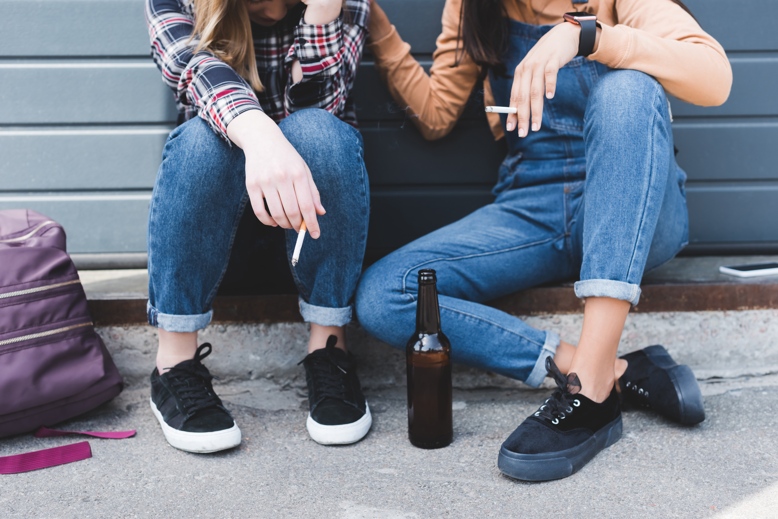
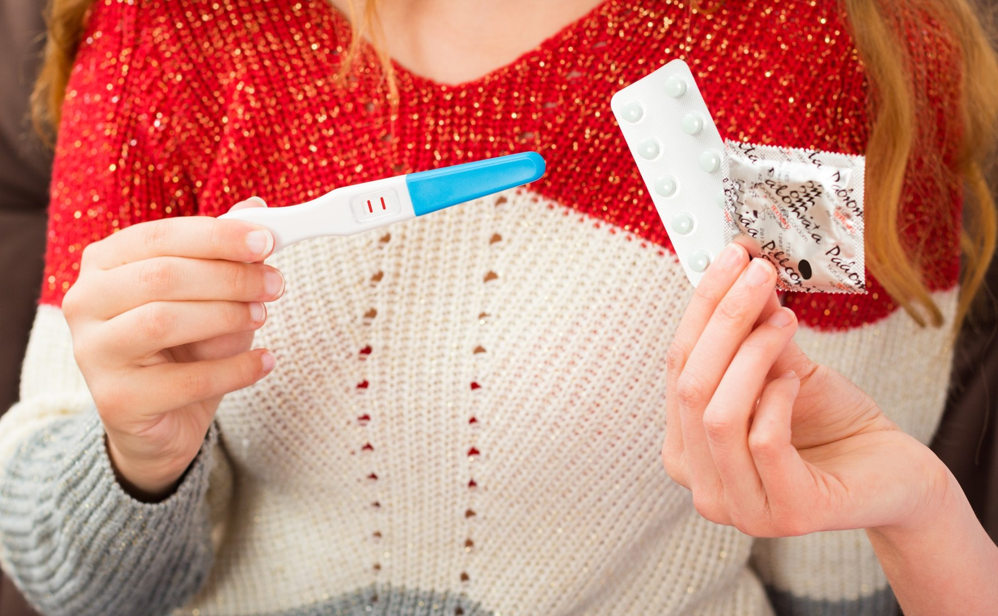
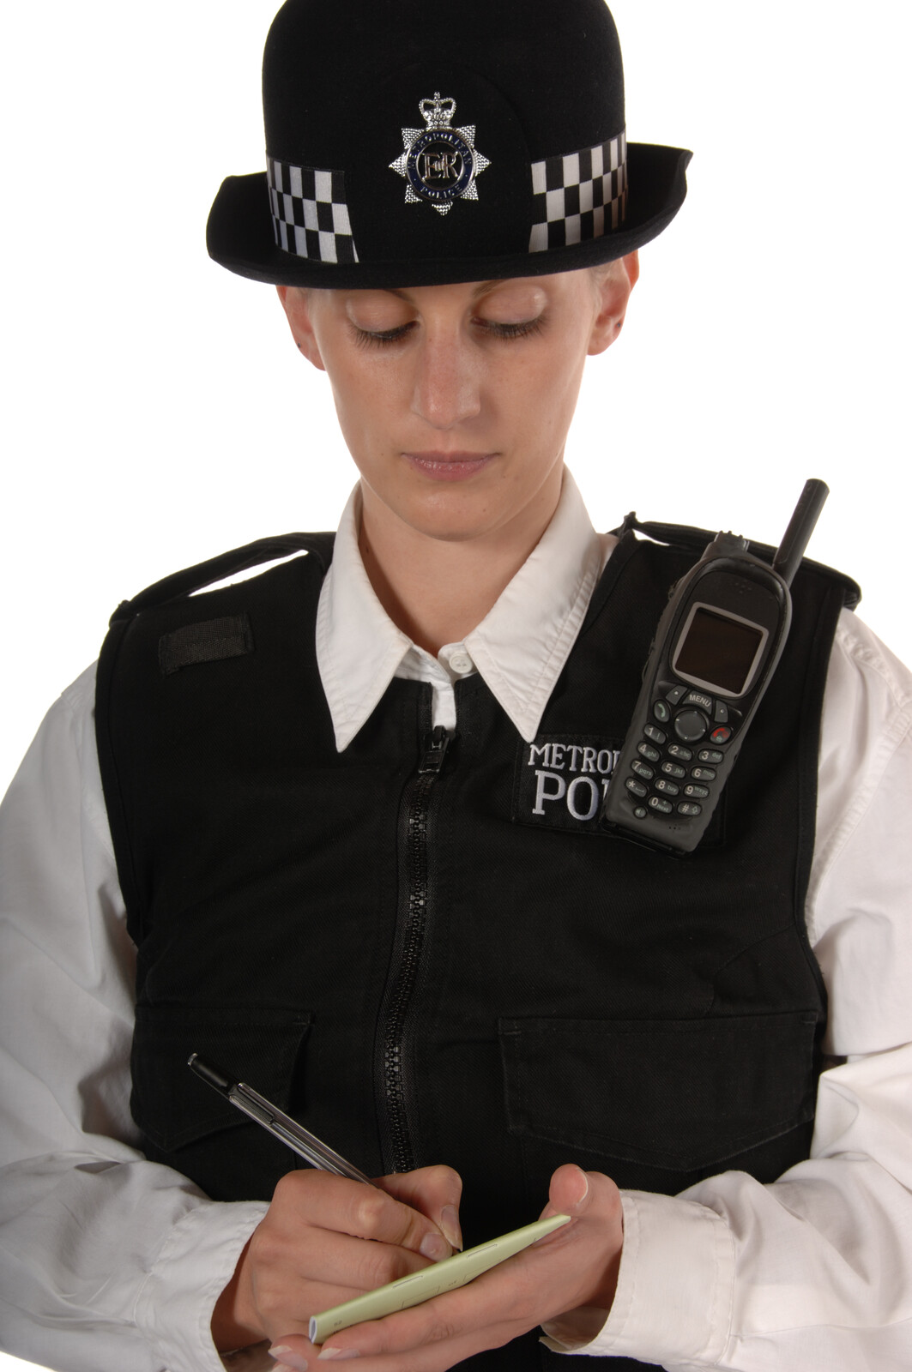
Drinking too much increases risks
Some adults may choose to drink alcohol. It is important to understand that
if someone drinks too much it increases risks.

Slide 14
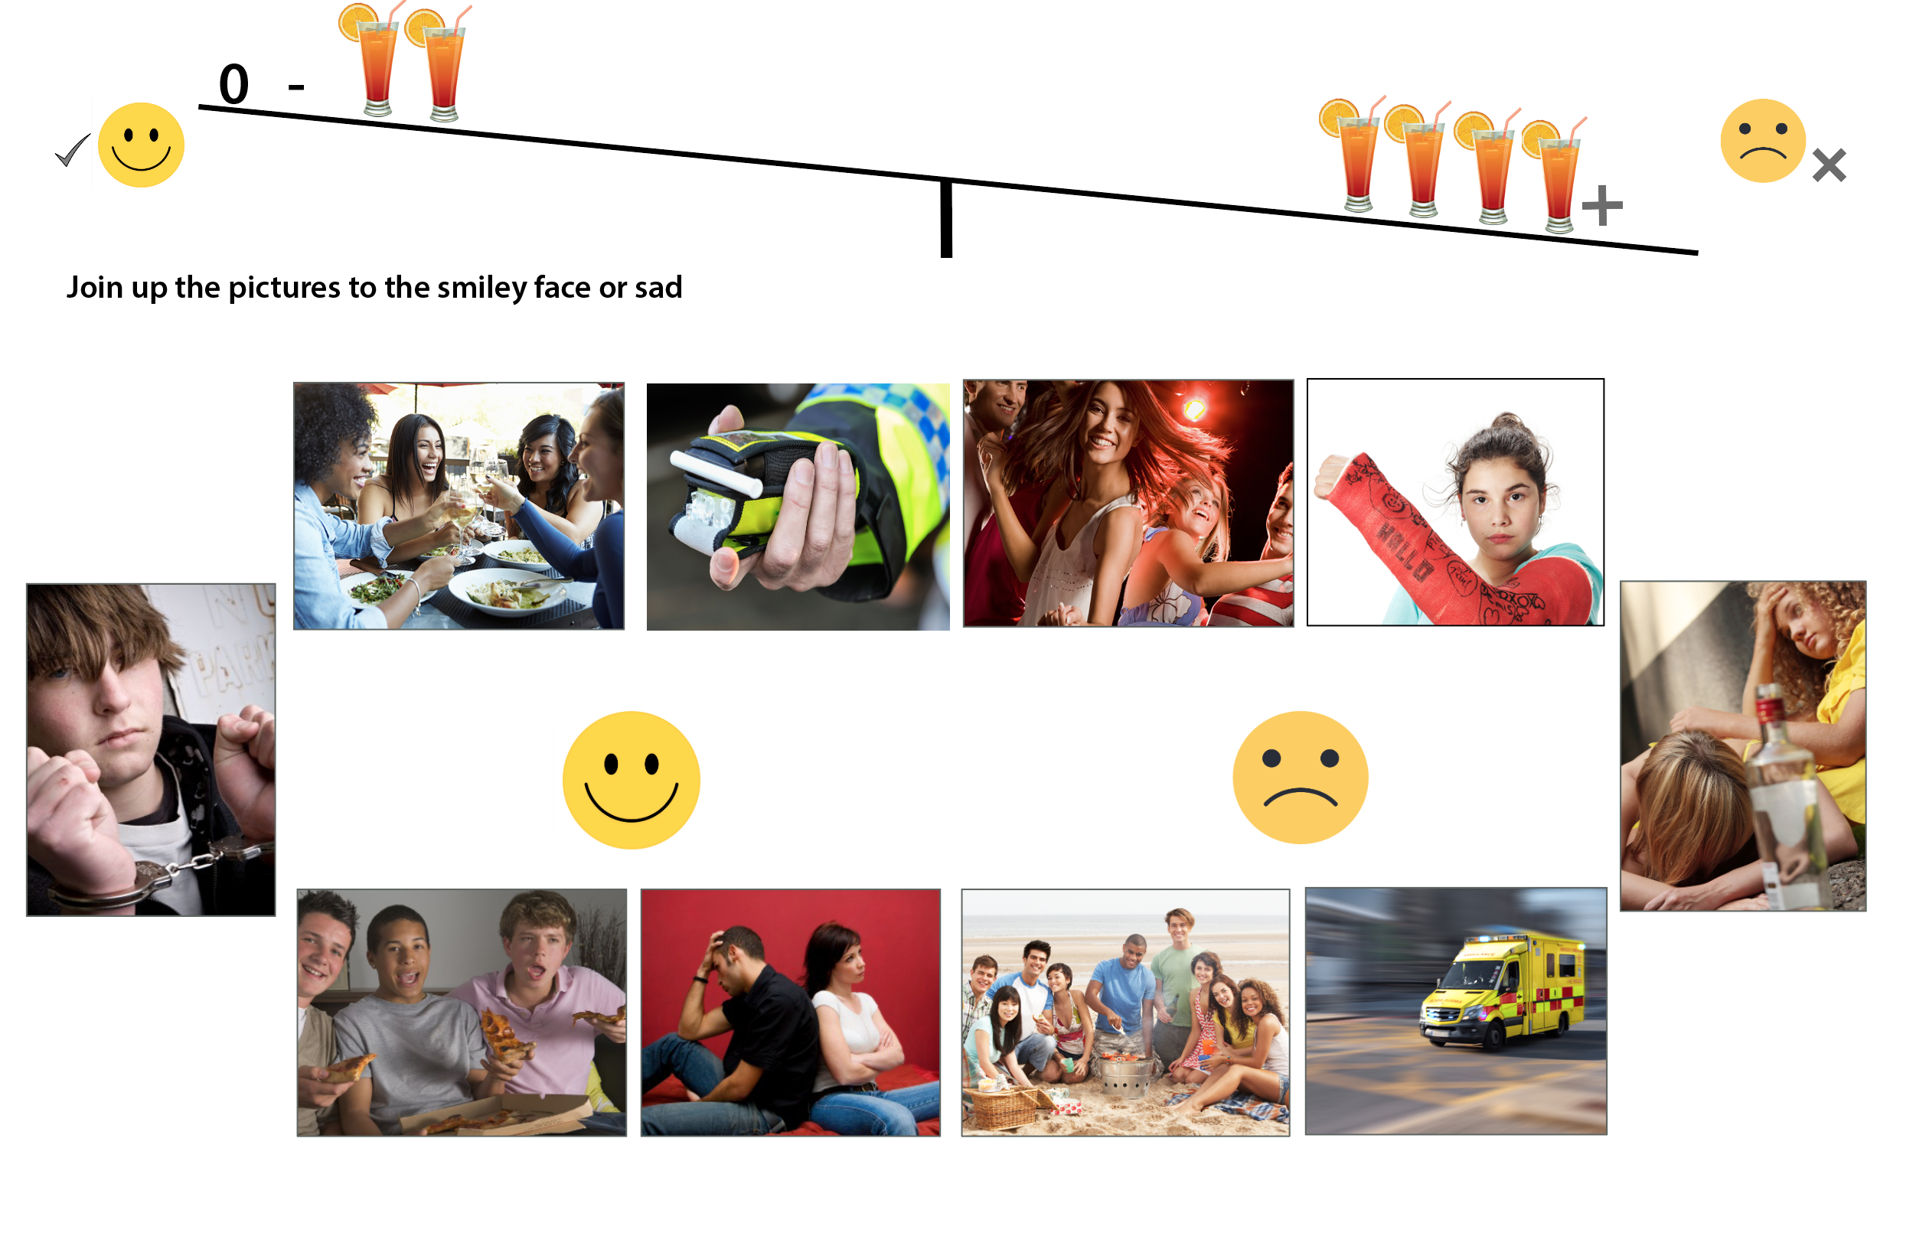
Getting the balance right – How much is too much?

Slide 15
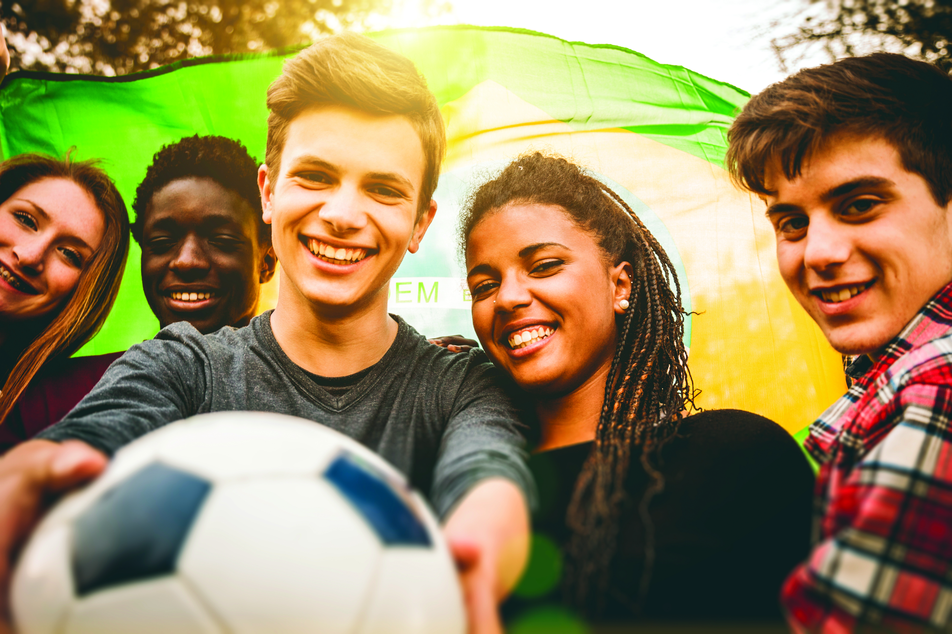
How many young people drink alcohol?
Remember
For young people under 16
Most have not had a whole alcoholic drink.
Very few drink weekly
Very few get drunk.
  Young people under 18 should not drink alcohol as their bodies and brains are not fully developed - so alcohol tends to affect young people more than adults.
Notes:
56% of young people aged 11-15 have not ever consumed a whole alcoholic drink. Less than 10% drink weekly or more frequently.
Less than 10% report getting drunk in the past 4 weeks.

Slide 16
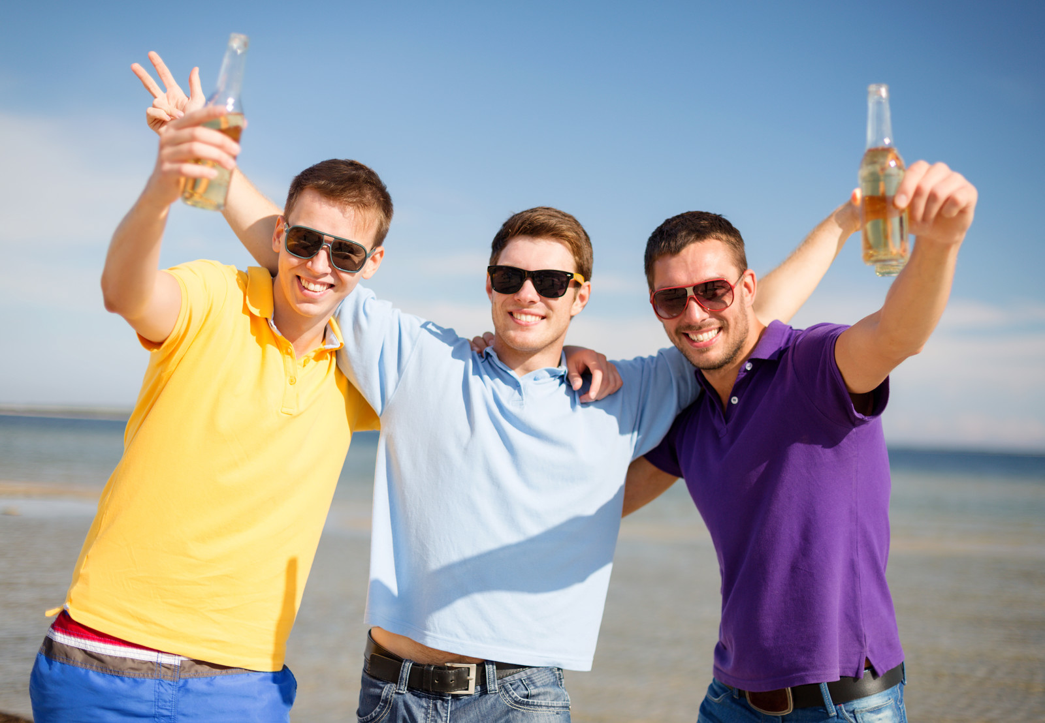

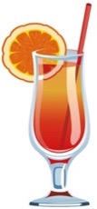
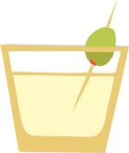
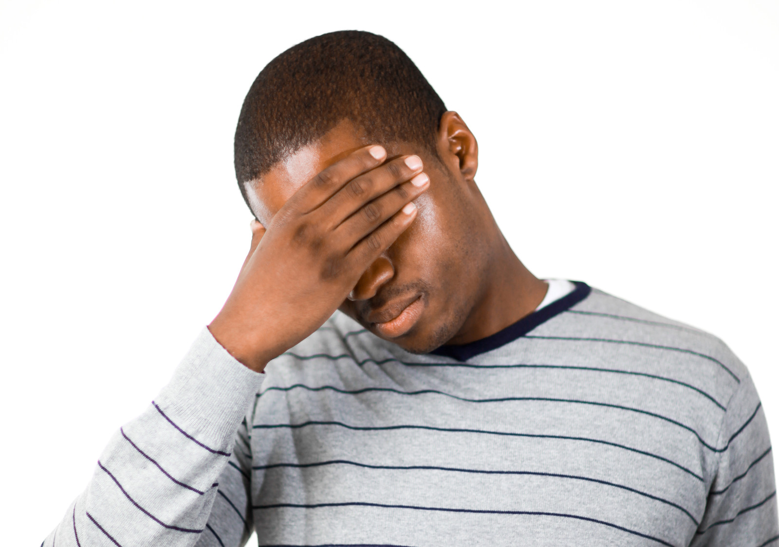




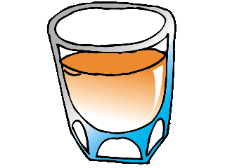
How much alcohol do you think would lead to these things happening
No alcohol
2 drinks
4 drinks
6+ drinks
Notes:
Try the 0-2 -4 -6 game – how much alcohol do you think would lead to you doing these things? You can use the happy and sad faces too!

Slide 17
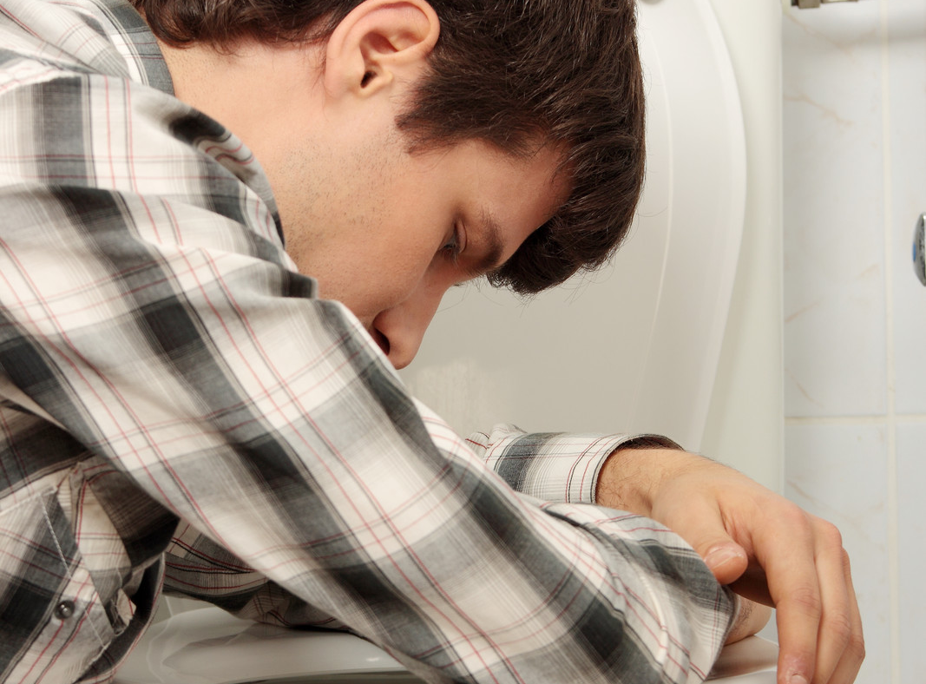
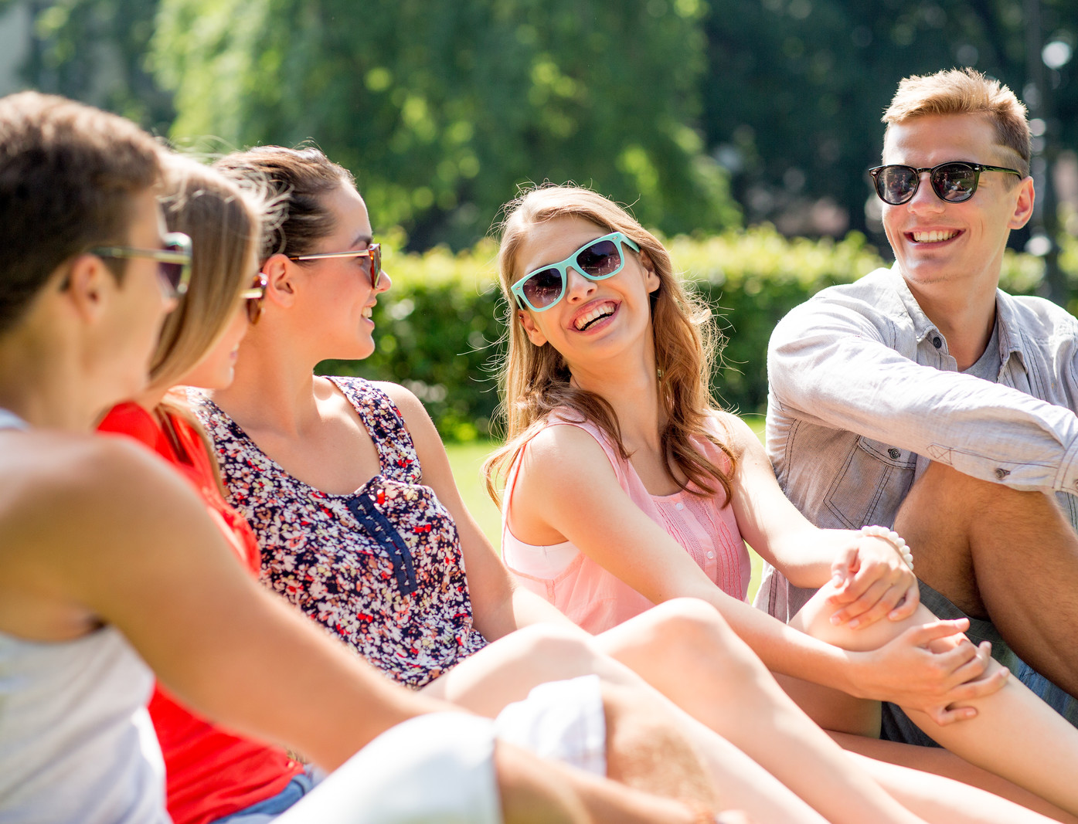
How much alcohol do you think would lead to these things happening
No alcohol
2 drinks
4 drinks
6+ drinks
Notes:
Try the 0-2 -4 -6 game – how much alcohol do you think would lead to you doing these things? You can use the happy and sad faces too!

Slide 18
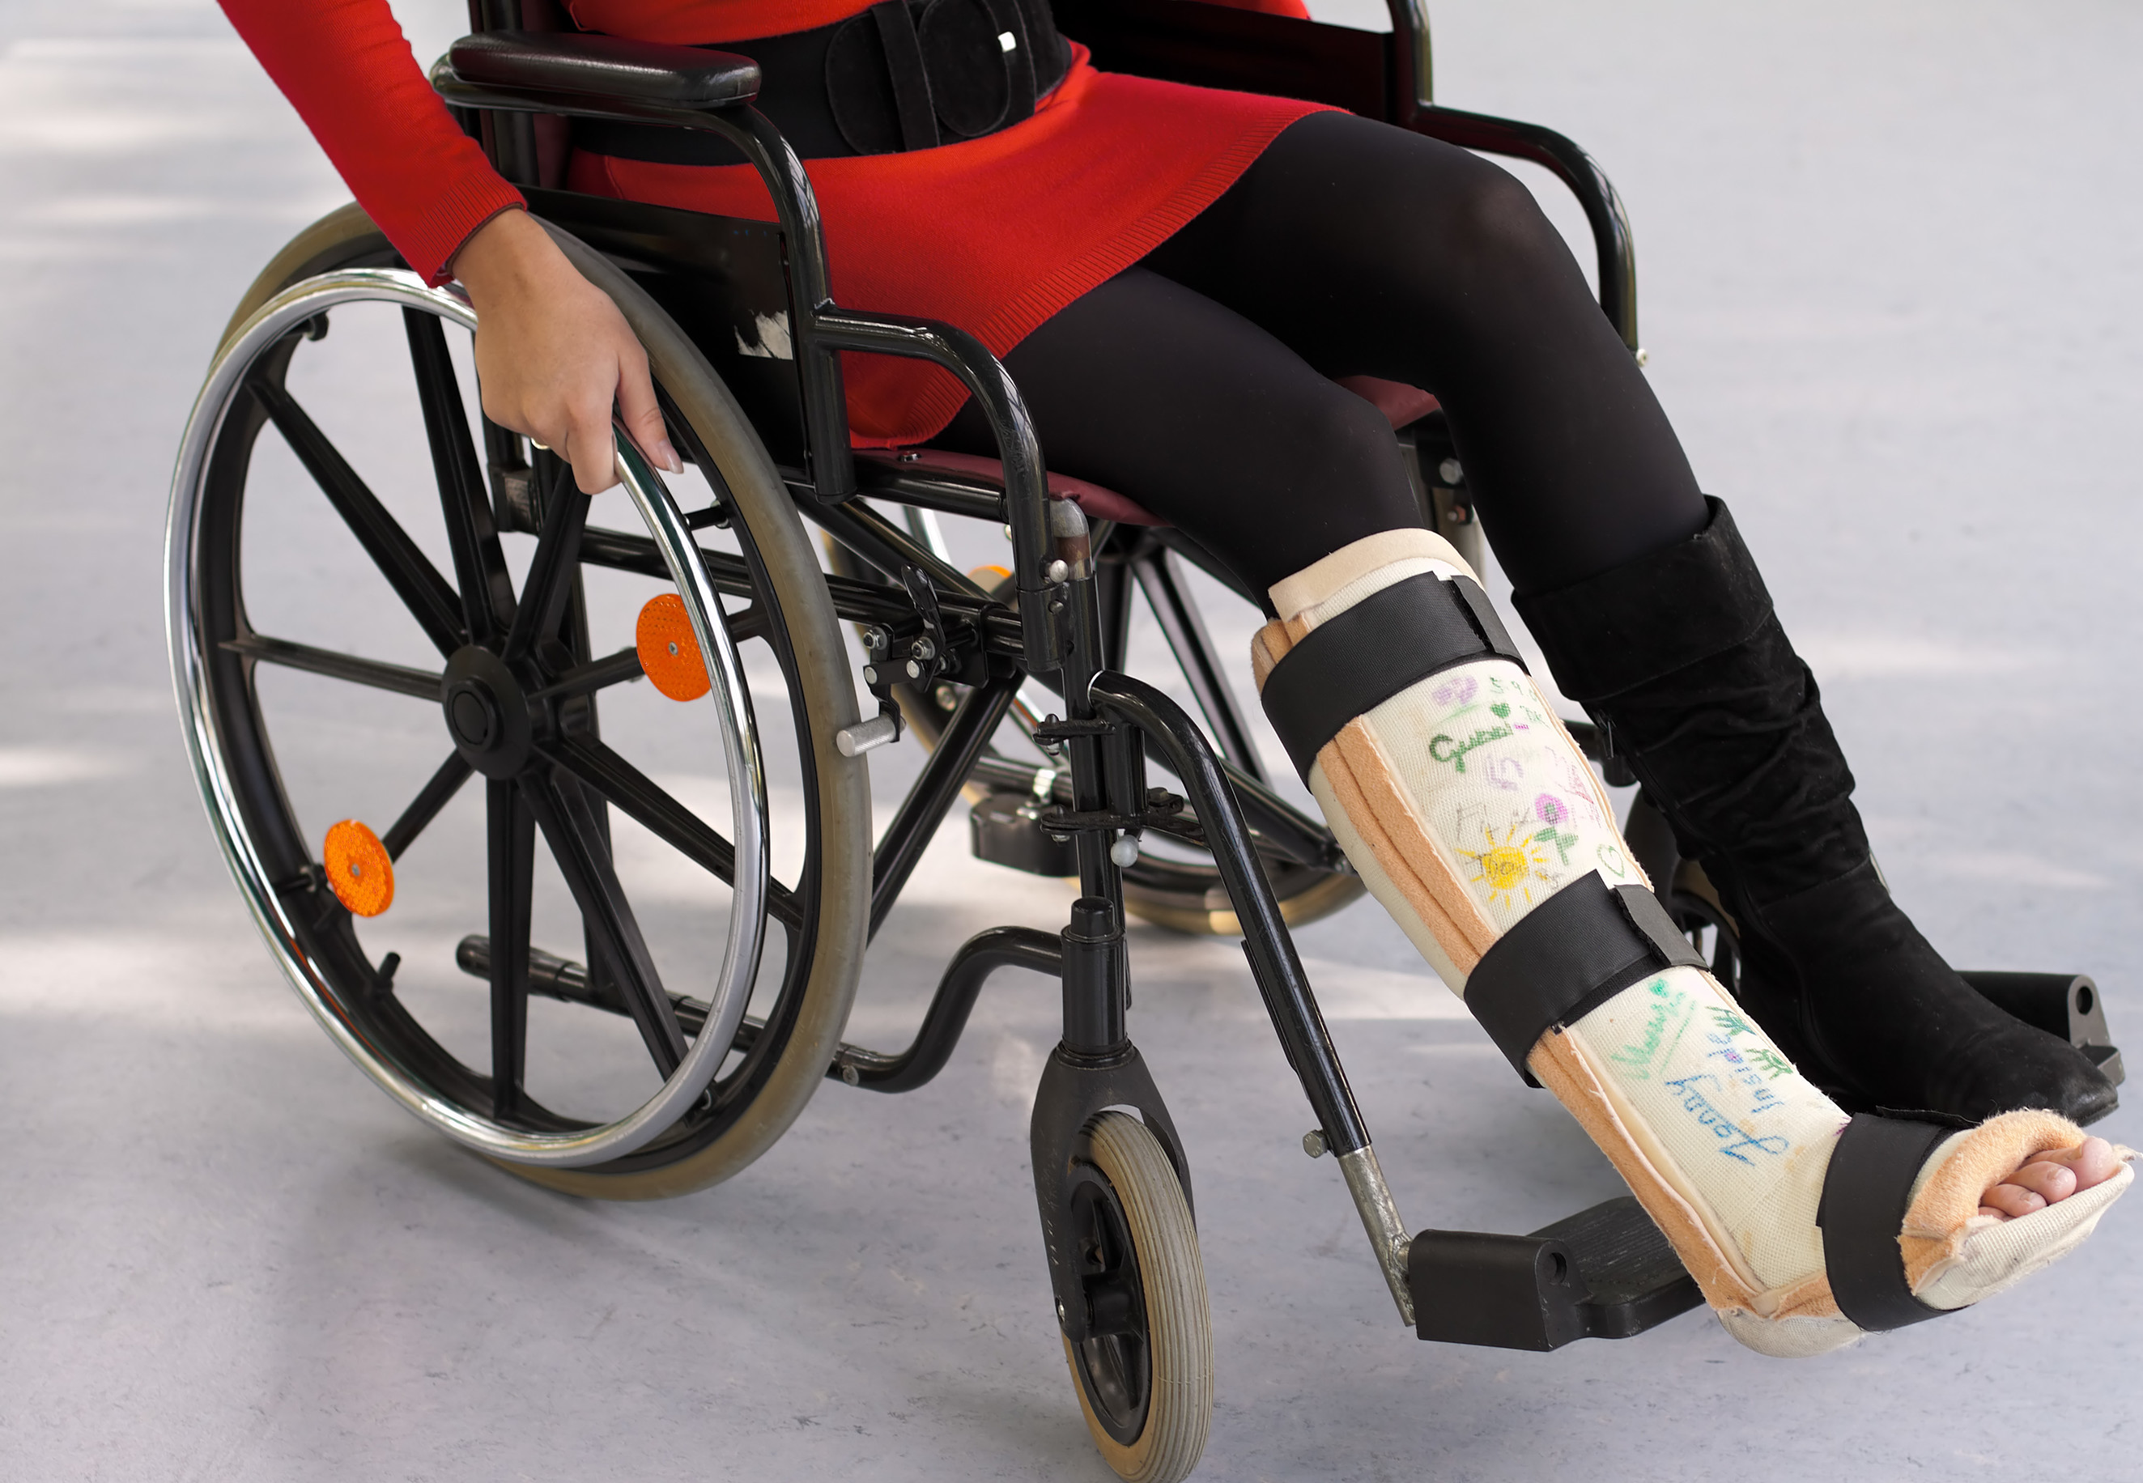
How much alcohol do you think would lead to these things happening
No alcohol
2 drinks
4 drinks
6+ drinks
Notes:
Try the 0-2 -4 -6 game – how much alcohol do you think would lead to you doing these things? You can use the happy and sad faces too!

Slide 19
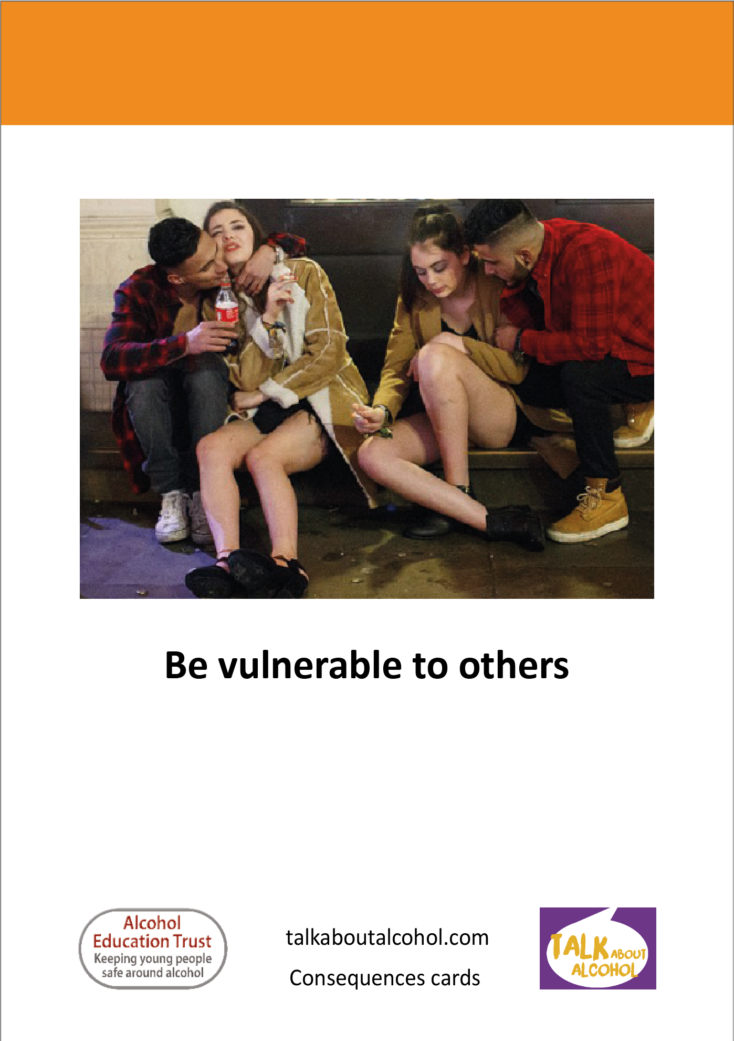
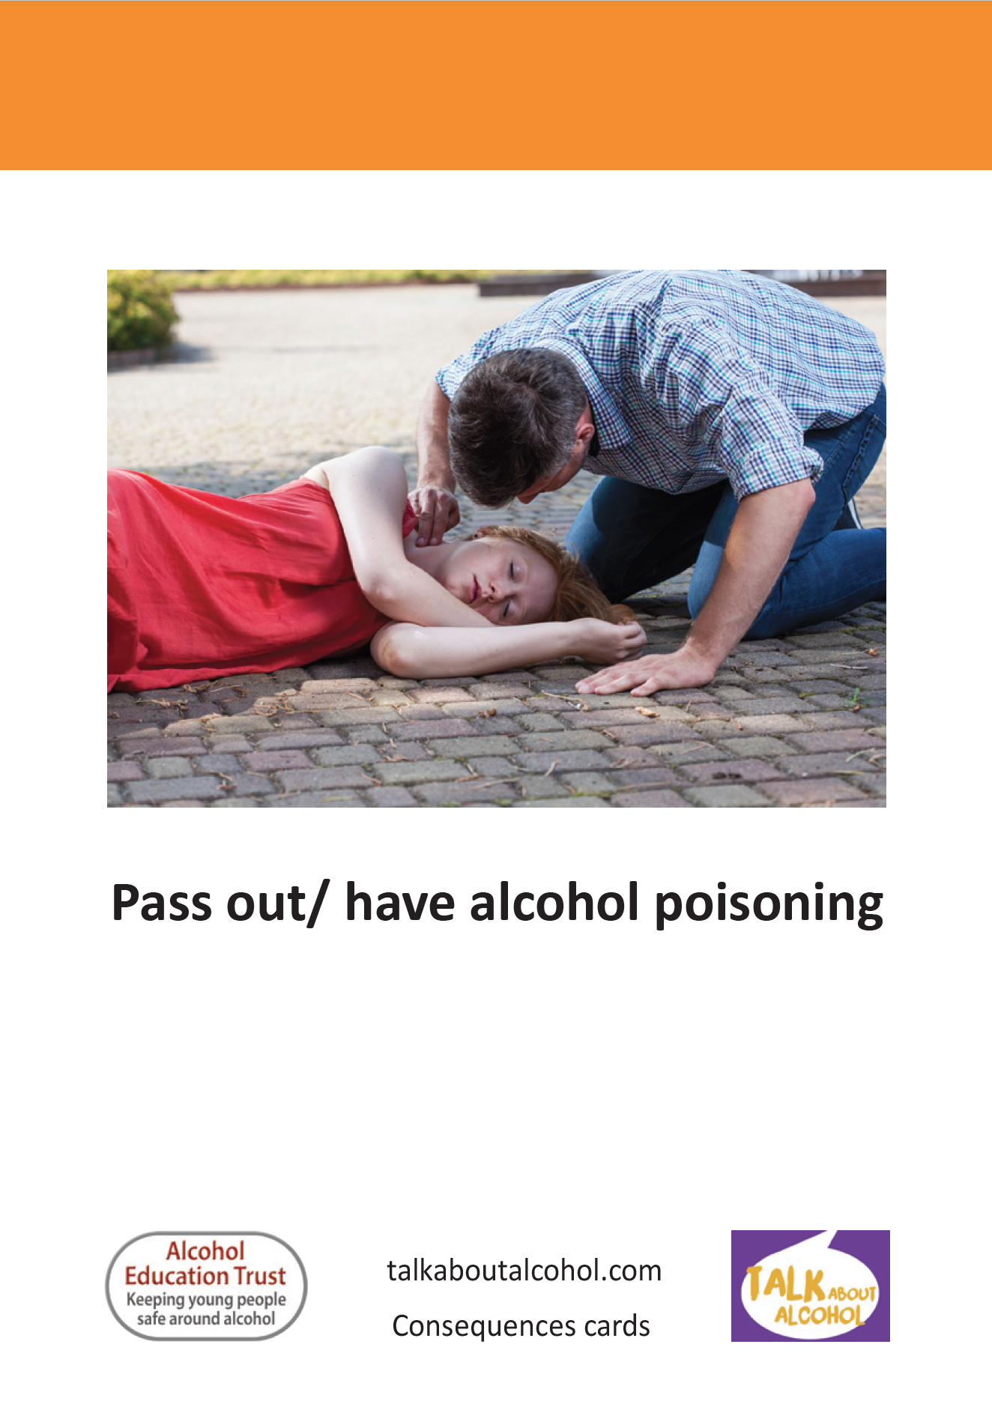
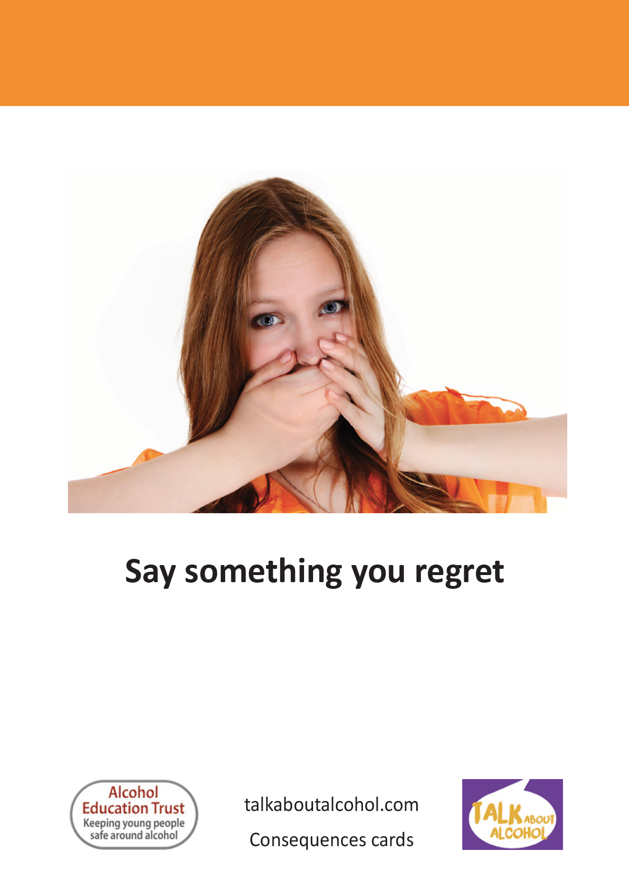
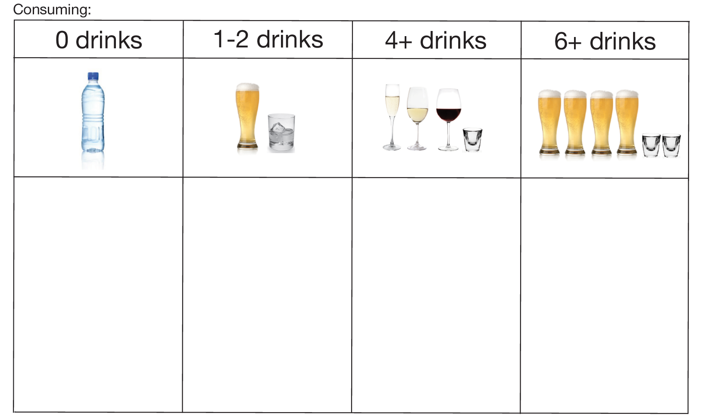
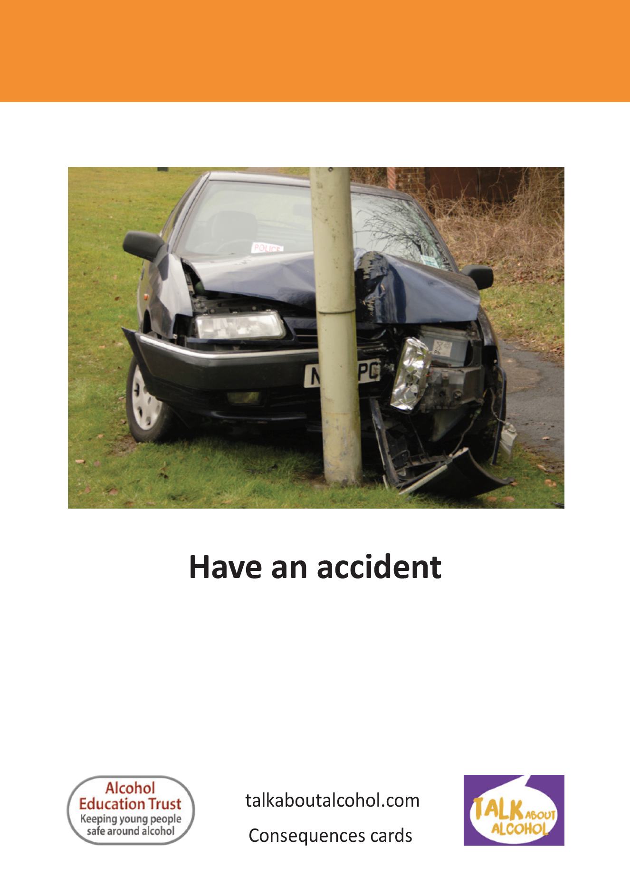
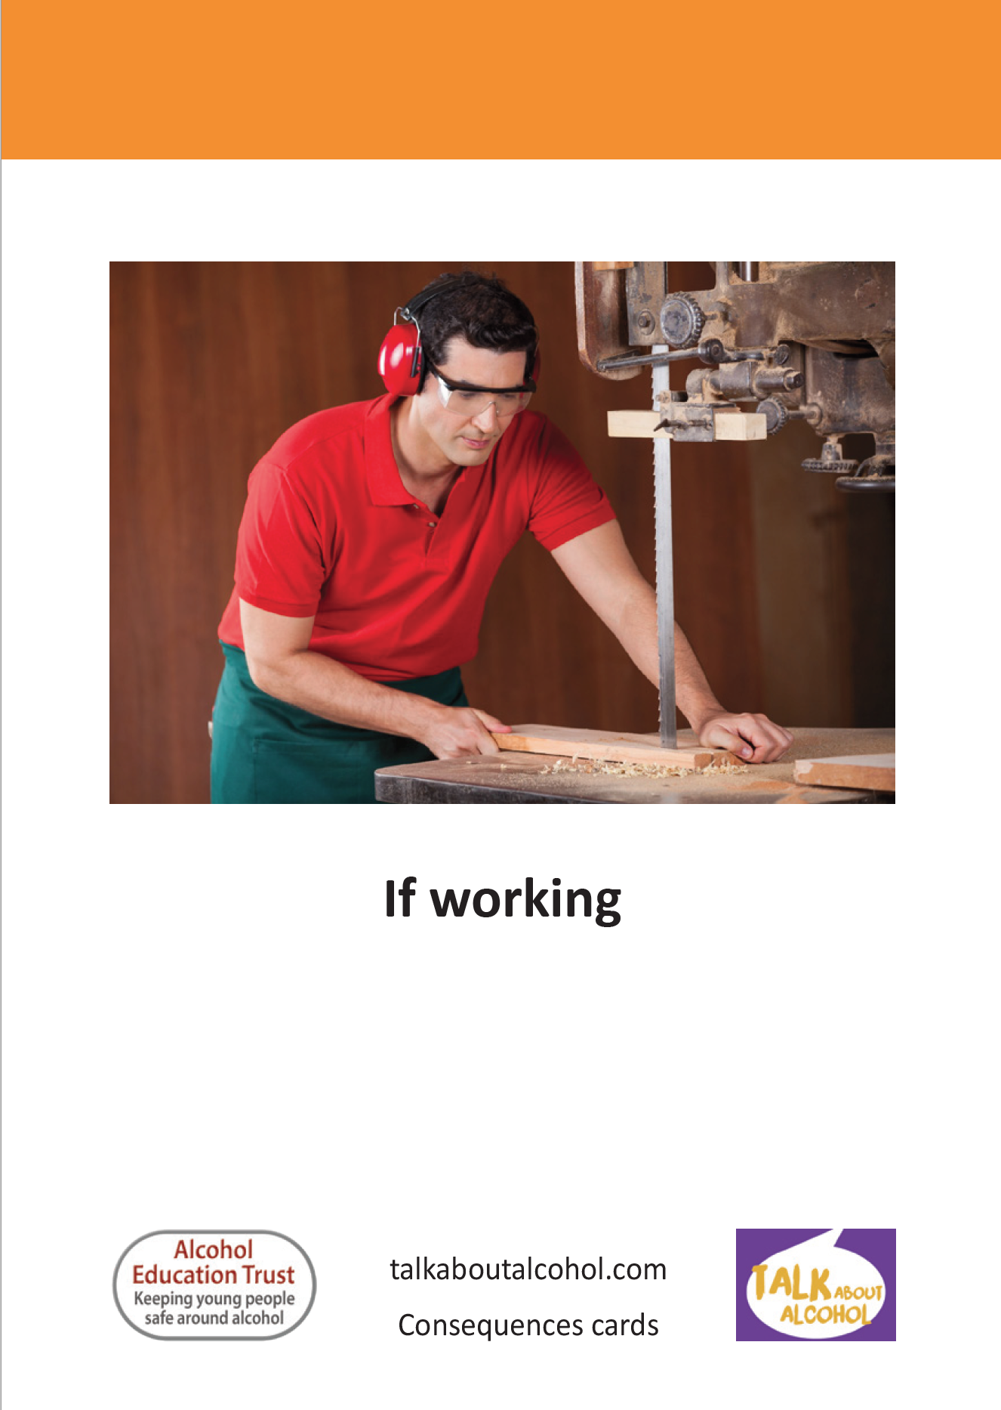
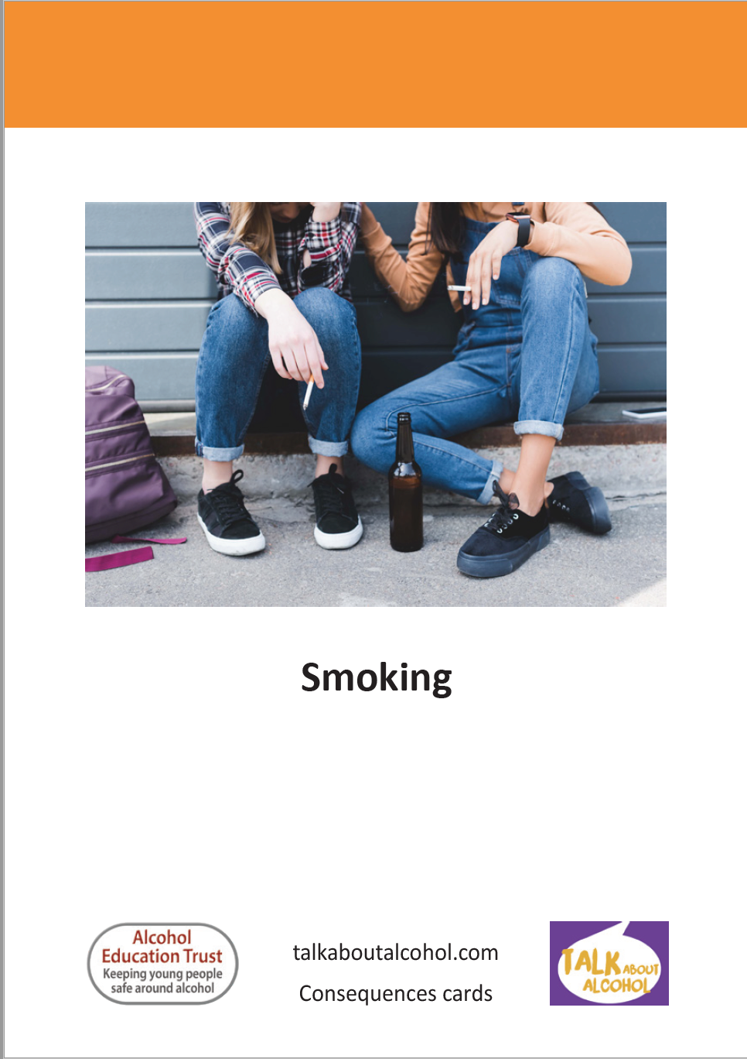
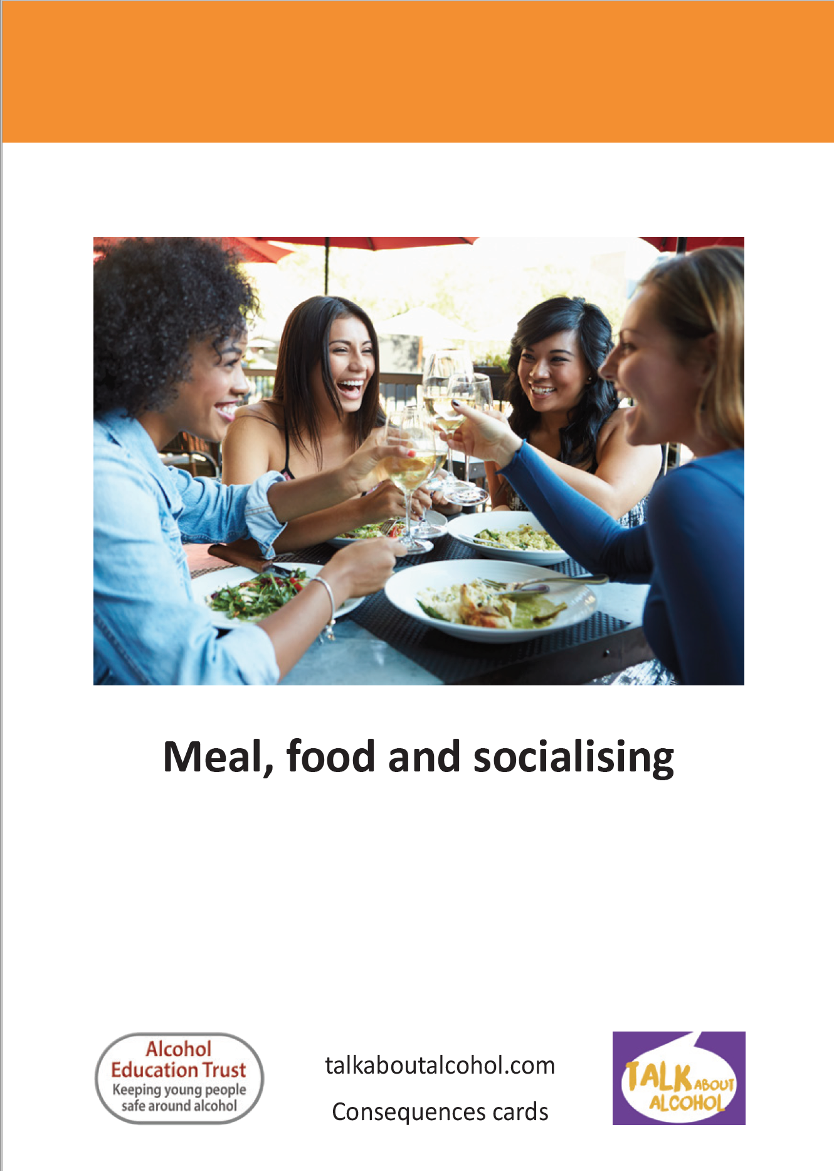
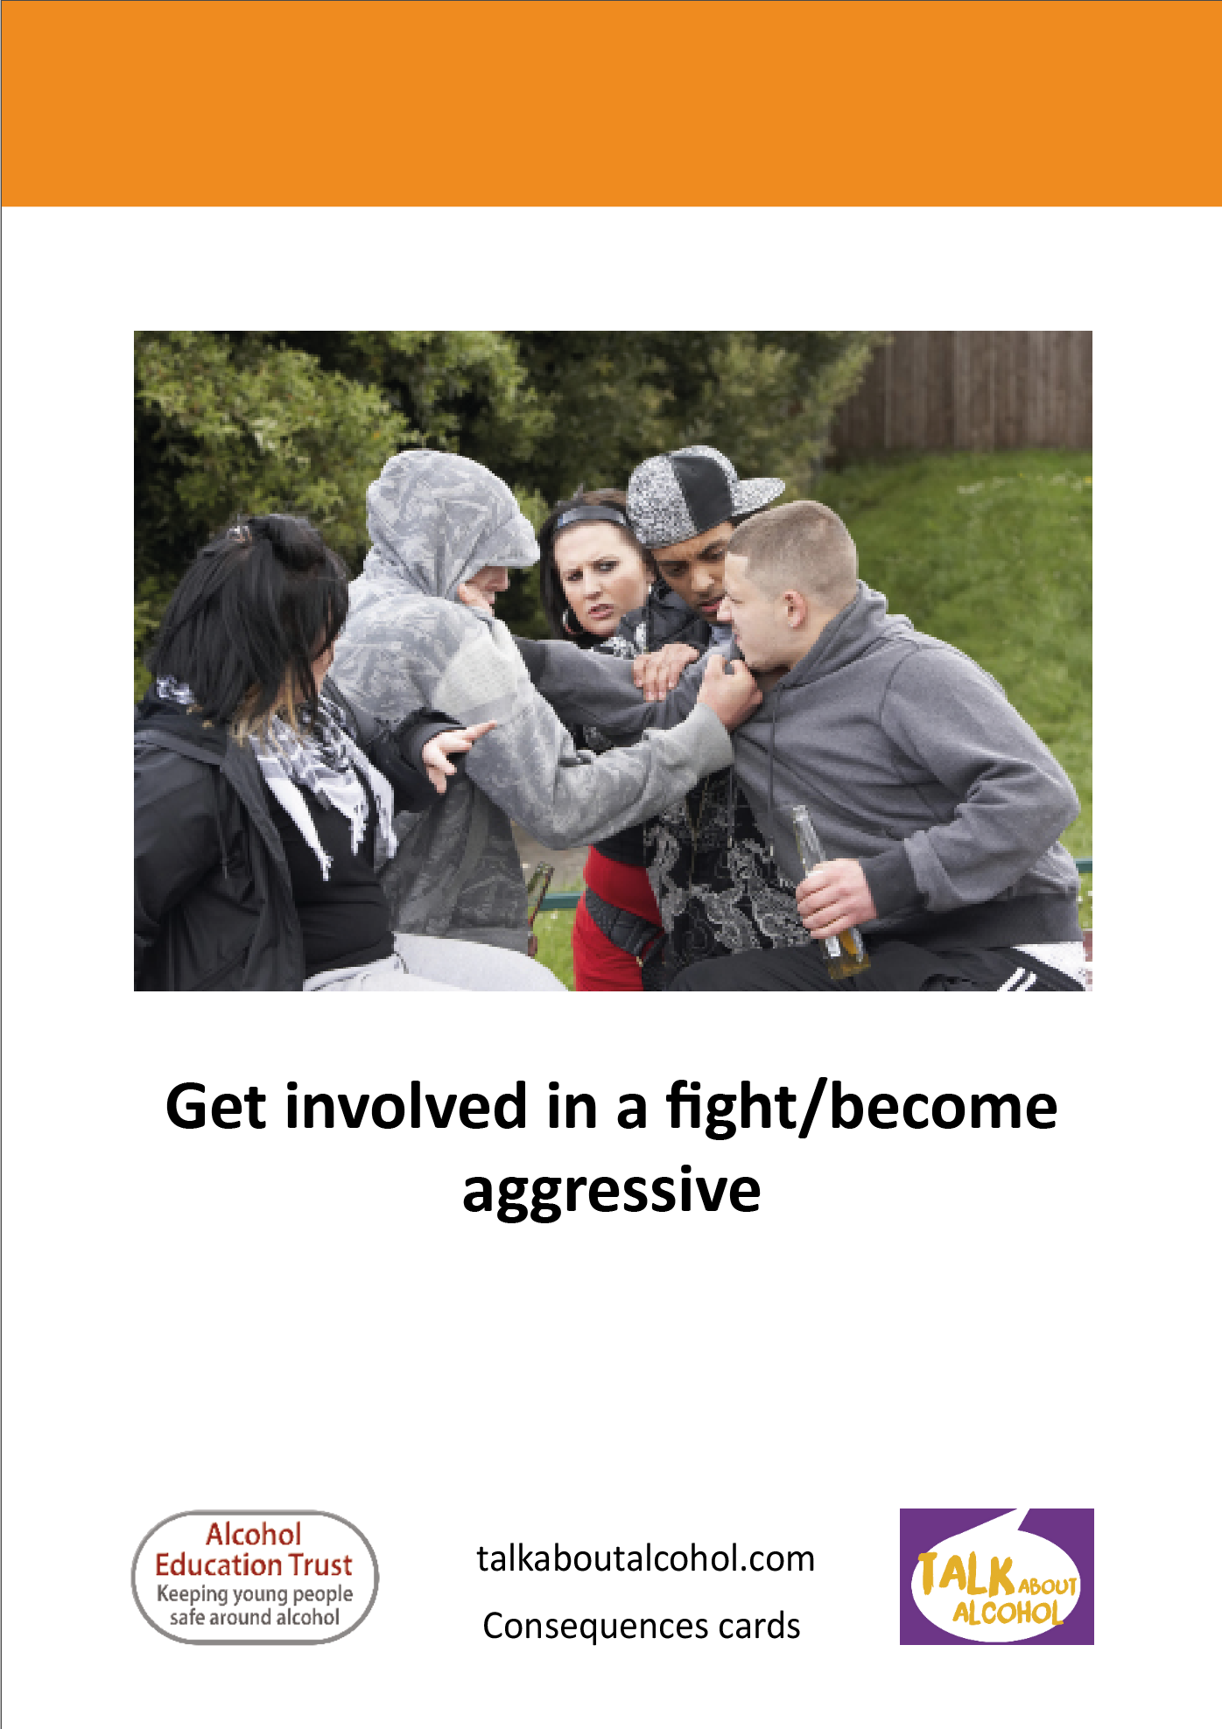
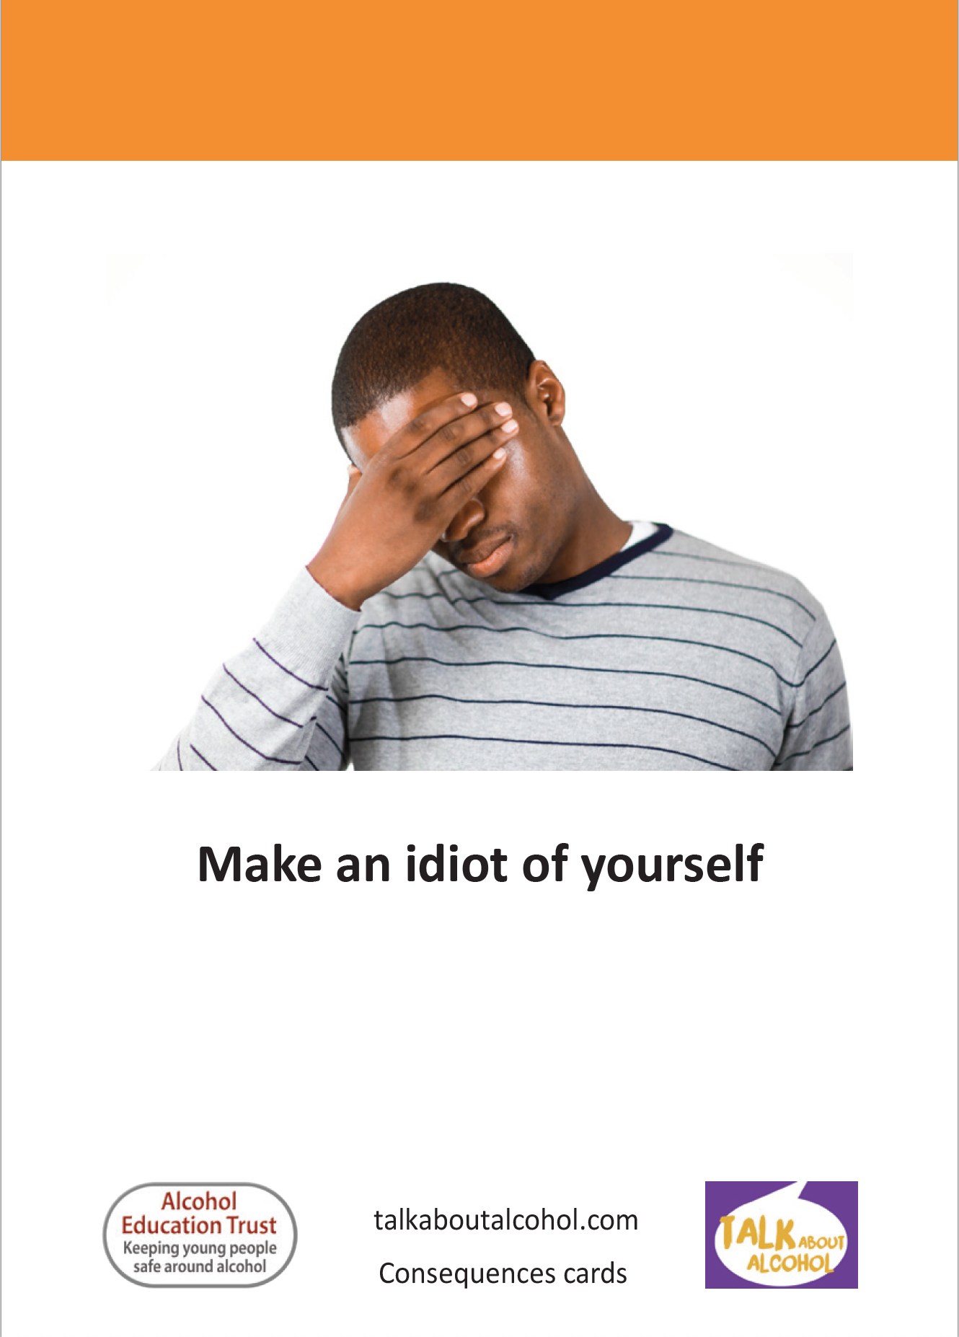
How much alcohol do you think would lead to these things happening
Place each statement card next to the number of drinks that you think would lead to the consequence.
When should someone not drink at all? Some pictures belong here.
Notes:
Questions for discussion:
Would how quickly you drink the drinks make a difference?
Would alternating a soft drink with an alcoholic drink make a difference?
Would eating before or while drinking have an effect?

Slide 20
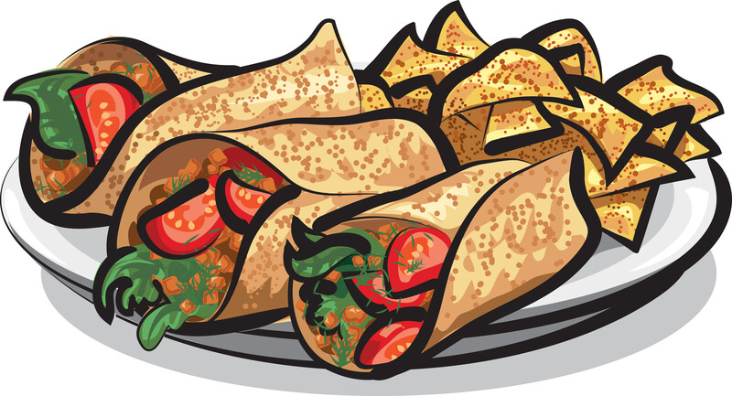
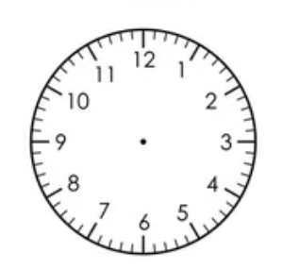
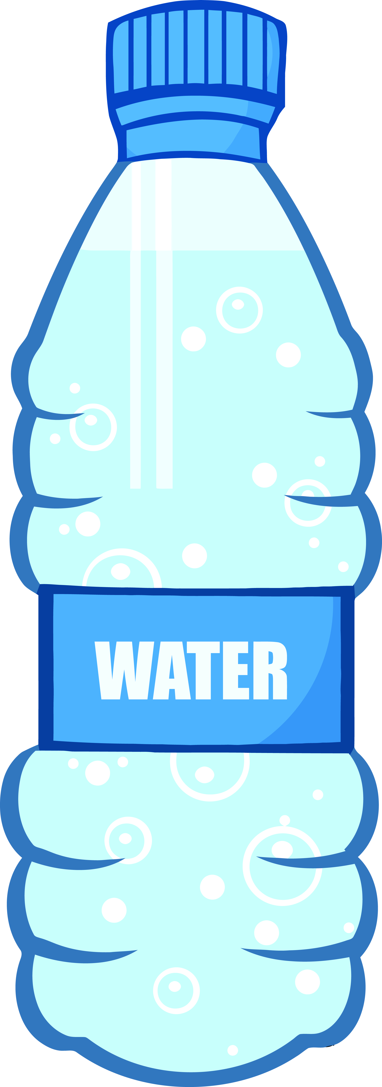
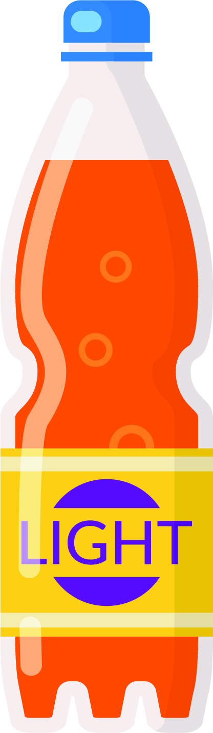

To reduce alcohol related harm…..
Remember to....
eat
pace
hydrate
Notes:
Use the summary slide to recap on the importance of eating before or while drinking, pacing drinks (i.e. not drinking too much too quickly) and alternating with non-alcoholic drinks to slow keep hydrated.

Slide 21



Alternatives to drinking alcohol
3 in 10 young adults aged 16 – 24 don’t drink alcohol
There are many alcohol-free drinks available
Bars and clubs must offer free tap water
Alternatives to drinking
Hobbies
Sport/ exercising
Group activity – watching a film, cards, games, bowling, gaming, eating together etc.

Slide 22

Harm reduction equations
Notes:
The teacher leads the group to use symbols to understand about how to reduce the harm that alcohol can cause.
The teacher uses the emojis symbols and some alcohol and non alcohol drink pictures Including options such as eating, chatting, gaming, dancing, soft drinks. These should be cut out and laminated.
The teacher creates a story using the characters Mike and Emma.
There are examples of emoji equations below and an example sentence could be ‘Mike has one beer at home with his family when his uncle comes round for a birthday party. Mike feels happy and they all say “Cheers, happy birthday uncle!” Then Mike has water when they eat the birthday cake’.
Examples of Harm Reduction Equations
Emma feels shy, she has a cocktail and feels OK and then has a spirit and feels happy. After another cocktail, she feels sexy, but ends up feeling sick and worried about what behaviour has taken place.
Different results can be created by matching up the symbol. e.g. the character can be having a good time but chooses to drink water and have a snack as well as an alcoholic drink so he does not end up unwell from drinking too much.

Slide 23

Harm reduction equations
Notes:
Mike feels a bit worried, drinks one beer and feels happy. He chats with a friend and has something to eat, then has a soft drink and feels content

Slide 24



Create you own harm reduction equations
Create your own harm reduction equations

Slide 25
What have we covered today?
We have seen how alcohol might affect someone’s feelings, behaviour and how they make decisions.
We learnt that most young people under the age of 16 haven't even tried alcohol and that they don't drink regularly or heavily.
We discovered how drinking in some situations increases the risk of harm.
We explored the idea that the amount a person consumes is tied to their risk of harm.

Slide 26
What can you remember?
CAN YOU……
Give an example of a situation where alcohol consumption is likely to lead to harm.
Give two outcomes that are likely to happen after drinking one or two drinks.
Give two outcomes that are likely to happen after drinking a lot of alcohol.
What should someone remember to do when drinking alcohol to reduce the risk of alcohol-related harm.

Slide 27
Talk about alcohol
Emotions AND FEELINGS

