Slide 1
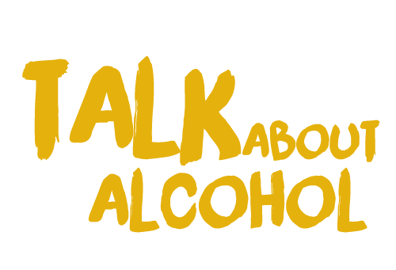

Talk about alcohol
Do you feel confident saying ‘yes’ or ‘no’?
What is consent?

Slide 2
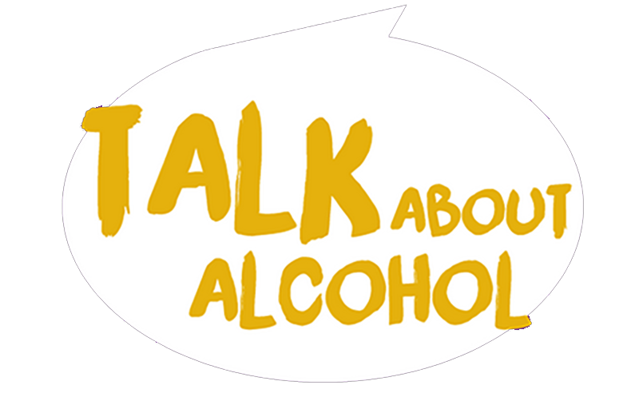

Learning objectives
We will
Consider how to say 'no' in an effective way to resist peer pressure to drink alcohol.
Learn what consent is.
Identify in different scenarios whether consent has been given or not.

Slide 3
Intended learning outcomes
I will be able to
Explain what consent is.
Understand how strategies can be used to resist peer pressure to drink alcohol and say 'no'.
Identify situations when someone is being pressured into drinking and should say ‘no’.

Slide 4
Ways of saying ‘No’
AGGRESSIVE
Violent, rude, angry, threatening
‘Do it!’
‘I'm the best’
‘Get lost’
Notes:
The teacher can introduce the idea of three different types of ‘No’ - ASSERTIVE, PASSIVE AND AGGRESSIVE - the printed cards (link) can help the participants to consider saying NO in these different ways.
The teacher can promote the Assertive one as being the best way to say No without being a push over or getting into a fight.
There are four good rules to remember when saying No.

Slide 5
Ways of saying ‘No’
PASSIVE
Quiet, scared, worried
‘You decide’
‘I don't know’
‘It's up to you’

Slide 6
Ways of saying ‘No’
ASSERTIVE
Confident, calm, clear, positive, respectful
‘I like this…. what do you like?’

Slide 7
Assertiveness
saying ‘no’
No
Use the word ‘No’
Notes:
The teacher can ask the students to practise these elements as a group or in pairs, suggesting simple scenarios to act out e.g. ‘give me your phone’
^{1 - Use the word NO}
^{2 - Give Eye Contact}
3 - Use a middle volume, no shouting
^{4 - Keep a serious face}

Slide 8
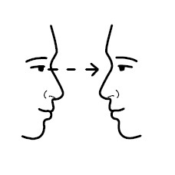
Assertiveness
Give eye contact

Slide 9

Assertiveness
x
Use a middle volume, no shouting

Slide 10

Assertiveness
Keep a serious face

Slide 11
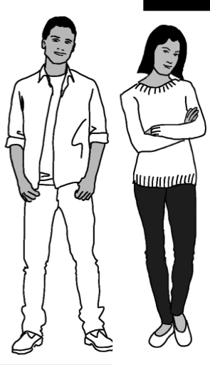
Let’s practice with Mike and Emma ways of saying ‘no’
Notes:
The character says NO to scenarios about unsafe drinking
The characters, Mike or Emma can try saying NO to some of the unsafe drinking offers without being rude.
The teacher can role play the part of an aggressive person with the character of Emma or Mike being role played by the students. The character can say NO using the strategies already discussed to some suggested questions.
e.g. Get me some cans from the shop. Have a shot, it’s only a laugh! Have a drink and give me a kiss!
Care will be taken to establish that this a role play and the teacher is playing a character too.

Slide 12
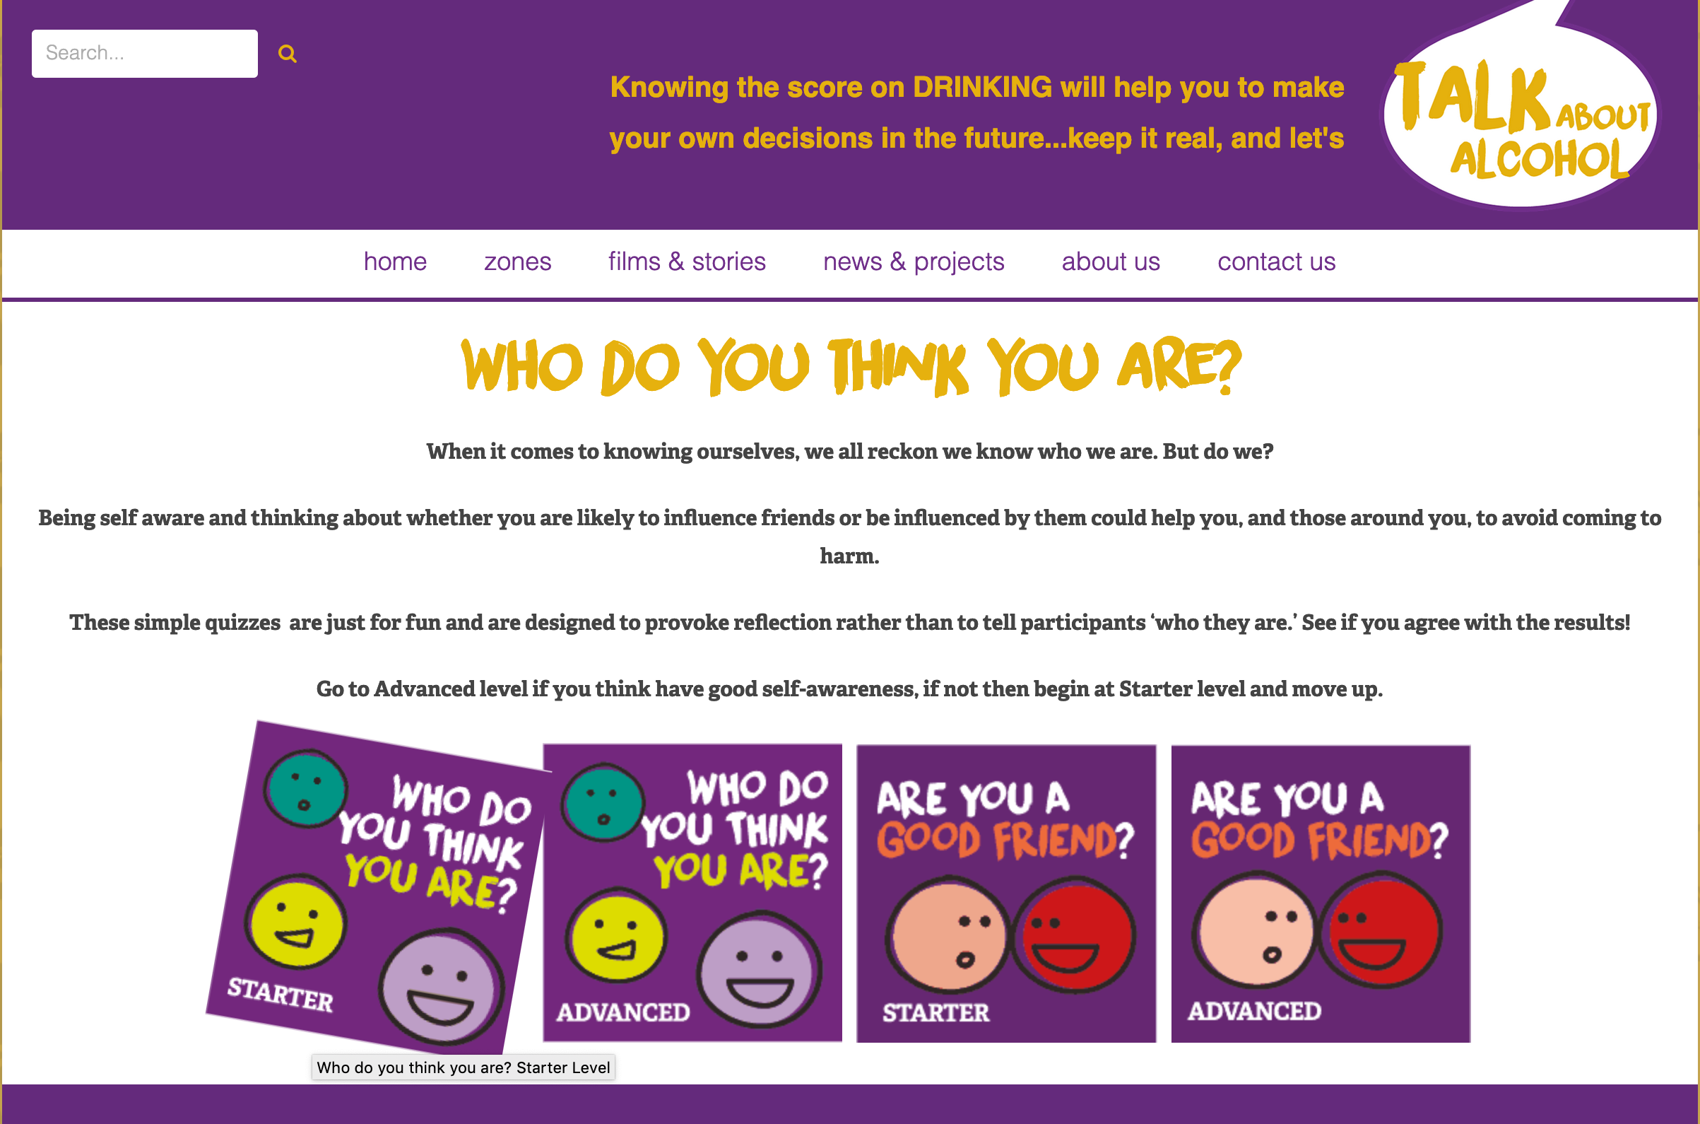
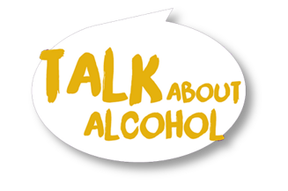
Are you a good friend?(optional)
Optional activity
Notes:
https://www.talkaboutalcohol.com/who-do-you-think-you-are-starter-level/

Slide 13





Saying ‘No’
Stop! No! Think and decide OK, Yes! | Don’t rush. Say ‘No’ if you’re not happy. Is it safe? Yes or No? If you’re happy and sure you’ve thought the decision through

Slide 14
Fudging - building excuses
Go on, give it a try!
I’m playing sport tomorrow
Notes:
This activity moves the skills for resisting pressure into a more sophisticated direction. It is often not enough just to say NO, so by learning the skill of ‘fudging’ participants can develop other ideas about how to refuse, in order to avoid drinking too much alcohol.

Slide 15
Fudging - building excuses
Have another one and give me a kiss!
I need to go to make a call… back in a minute

Slide 16
Consent
To agree to something, usually after really giving it some thought.
Both people understand exactly what is happening and what has been agreed.
Either person can change their mind at ANY time.

Slide 17
Consent = Agreeing to something
Consent = agreeing to do something
It must be your own free choice
You must not be under the influence of drugs or alcohol
It must be within The Law
Notes:
It must be a free agreement, not forced or coerced
It must be an agreement made not under the influence of drugs or alcohol
It must be within the law (ie OVER 16 FOR SEX, OVER 18 FOR BUYING ALCOHOL ETC)

Slide 18
Consent
No pressure
No threats
No bargains
No manipulation
No abuse of power

Slide 19
Consent
YES
YES
YES

Slide 20
Consent –
Should the characters say YES or NO?
Is there consent?
Can you spot any threats, manipulation or pressure?
What would you do?
Notes:
Option to use text scenarios around drinking and risk, single sentences or pictures

Slide 21
Consent –
Should the characters say YES or NO?
Worked example – see point on next slide
Kia and Jade take a half bottle of vodka to a house party (1).
They get talking to some older boys who they‘ve not met before and they all have some swigs from the vodka, until it’s gone (2).
The boys say they are going to drive to a different party that will be less boring and tell the girls to come with them (3).

Slide 22
Consent –
Should the characters say YES or NO?
Worked example
Kia and Jade are under 18 and therefore it would be better to not drink alcohol. Because they have been drinking they are not able to give consent.
Kia and Jade don’t know the boys, so it would be an unsafe choice to leave the party with them. They should say ‘no’ and make an excuse to stay at the party.
The boys may have drunk too much alcohol to legally drive a car and are more likely to have an accident.
No thanks…. We’re getting a lift home with Jade’s mum soon.

Slide 23
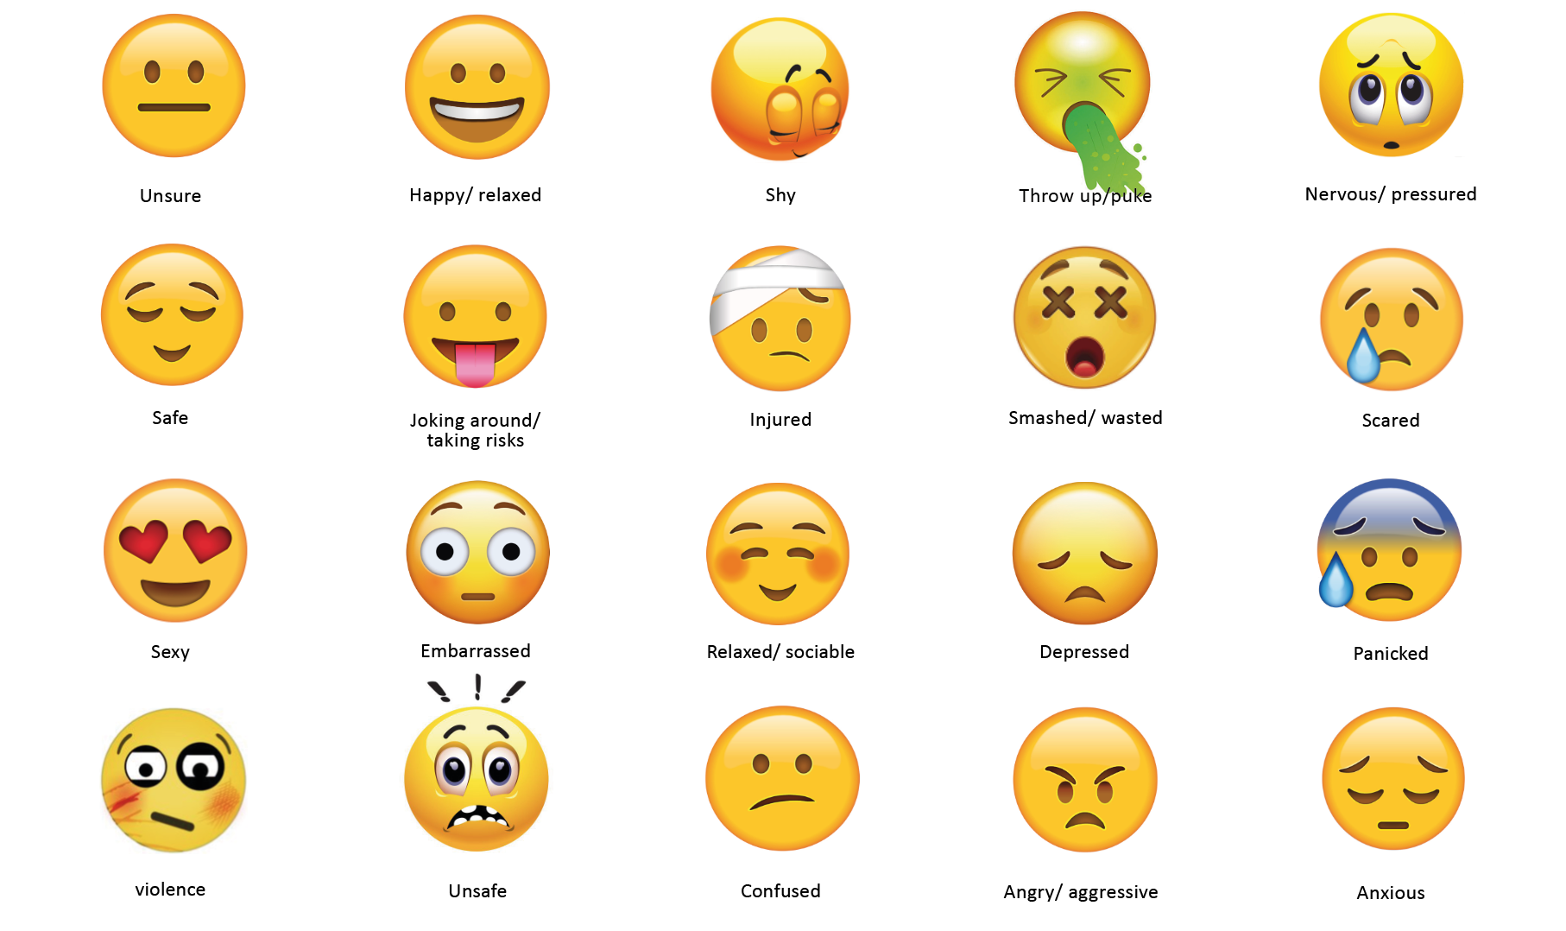
Use the different emoji faces to show how someone might feel – place them next to the picture or colour in the red, amber or green circle

Slide 24
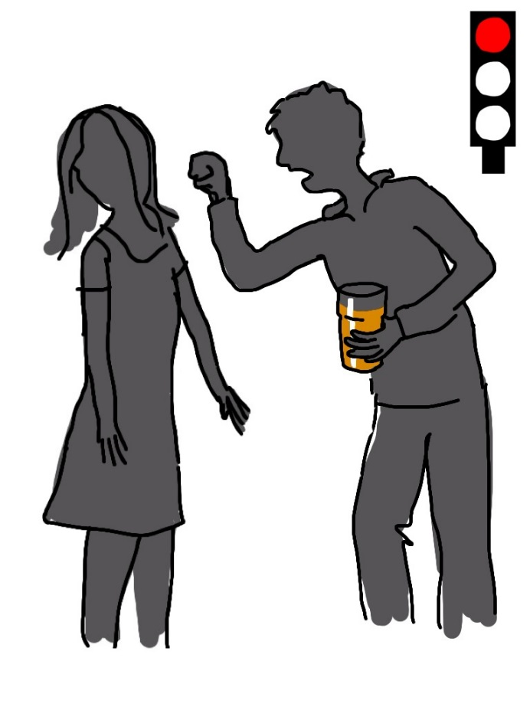

Not ok
The girl is being threatened in an aggressive way
Notes:
Here is an example that is not OK,
where a girl is being threatened in an aggressive way

Slide 25
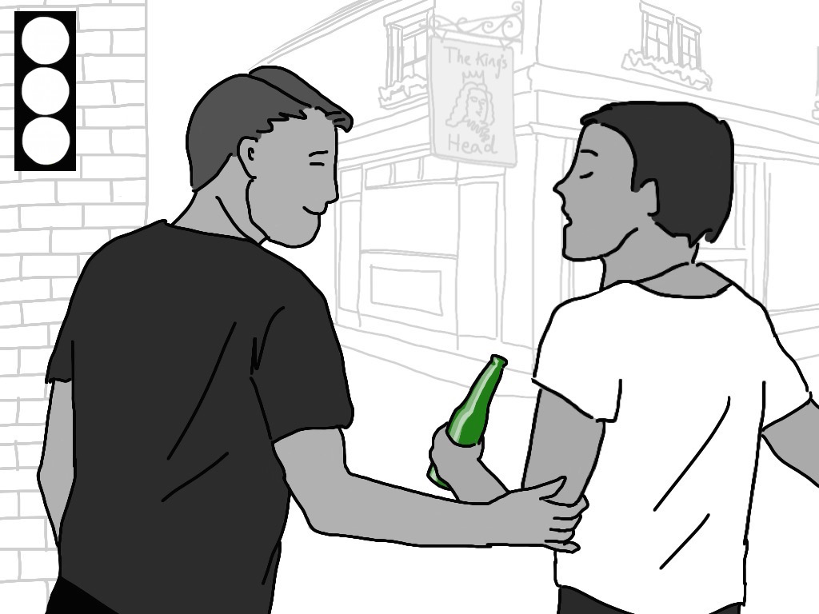
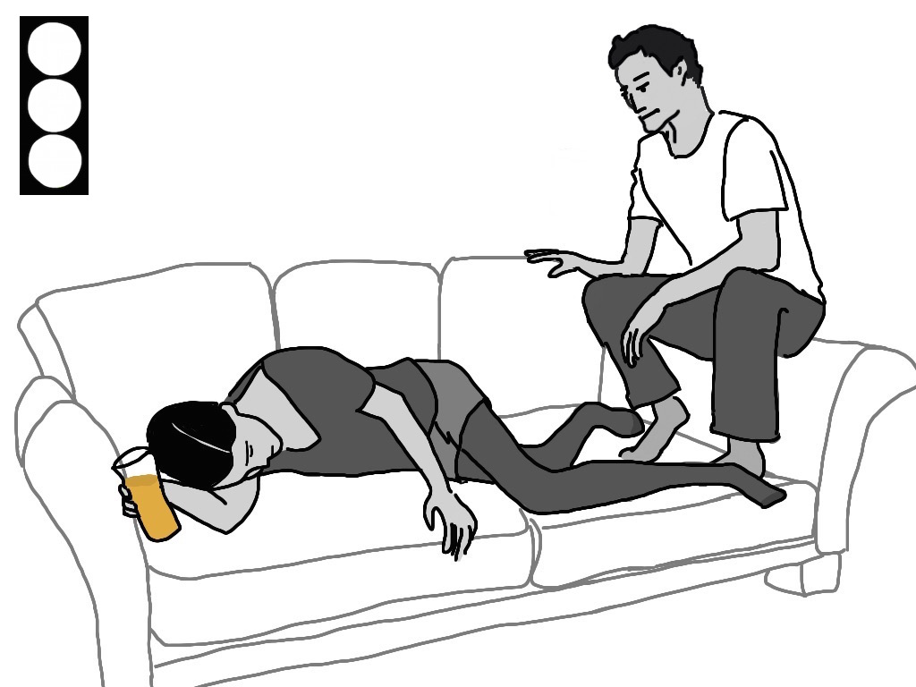
Notes:
Saying No Use the traffic light cards in the resource pack or the picture scenarios online or to drive a discussion about safe and unsafe ways to drinks and decisions that may need to be made.
Using the traffic light scale, ask pupils to judge whether the situation is very risky (red), risky (orange) or safe (green). Alternatively, use the emoji cards in the resource pack or from the emoji sheet online
The purpose of this activity is to empower the participants to feel able to give a No answer without it being aggressive or passive.
This is an important skill to be able to resist pressure to drink alcohol.

Slide 26
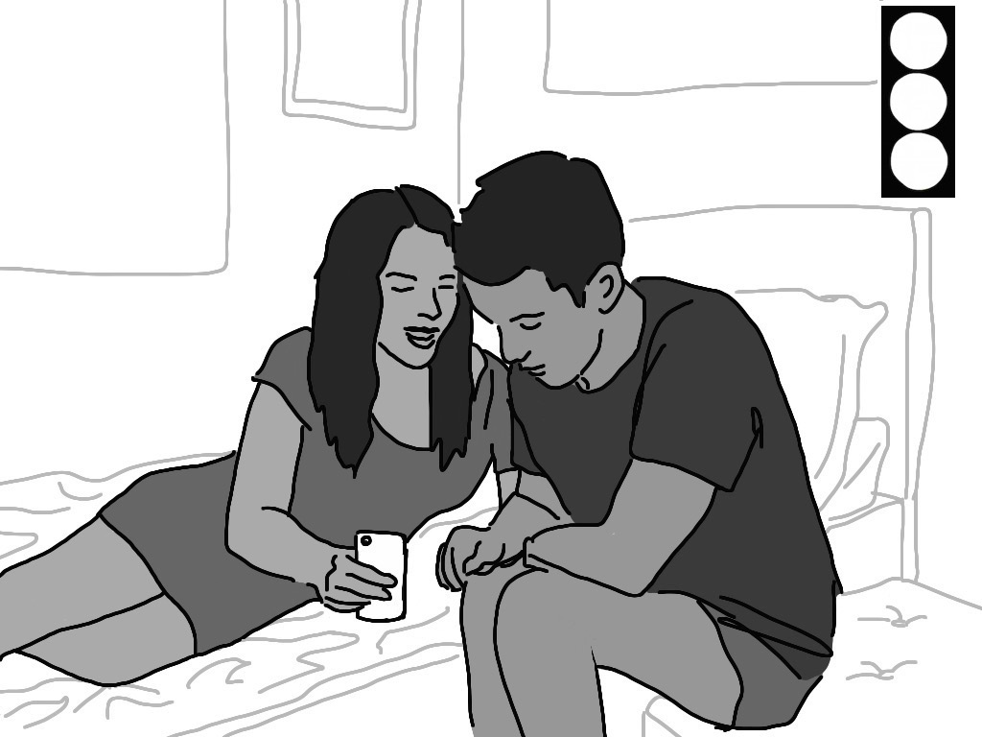

Slide 27
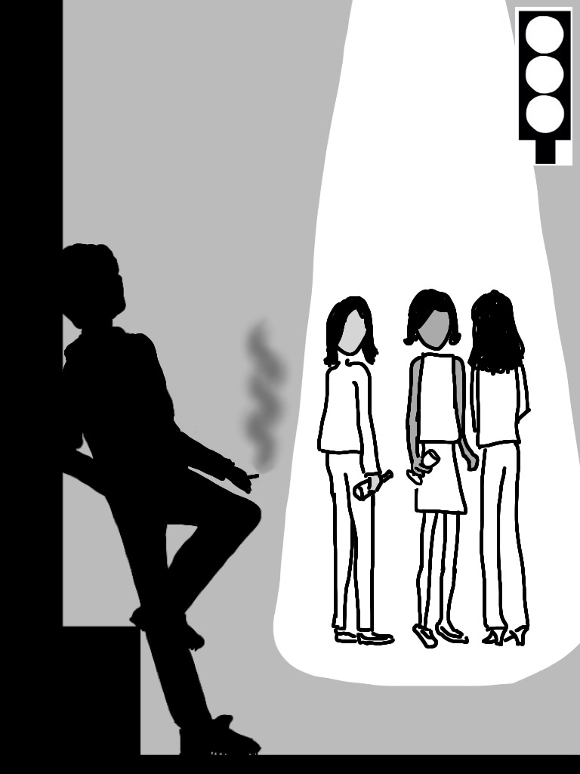
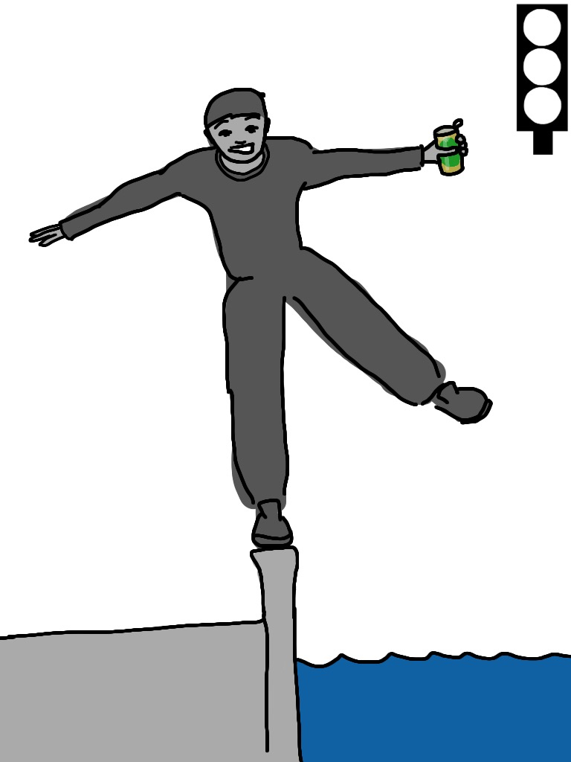

Slide 28
Women tend to be more affected by
alcohol than men
Notes:
TRUE: Alcohol travels around the body in water. The female body has more body fat and less water than the male body, so alcohol has less water to spread out in. Therefore, women tend to get drunk faster than men when drinking a similar amount of alcohol.

Slide 29

People who drink lots of alcohol regularly
may become addicted to it
Notes:
TRUE Someone who regularly drinks a lot of alcohol may have to drink more to get the same effect, and this can lead to addiction.
Being addicted to alcohol means someone feels that they need to drink and that they find it hard to stop drinking.
They may need a drink as soon as they wake up or feel they need to have a drink in the morning. If they aren’t able to drink alcohol they feel ill with withdrawal symptoms, such as sweating, shaking and nausea. These symptoms stops if they drink alcohol again.

Slide 30

Drinking alcohol reduces stress
Notes:
FALSE After a few drinks someone may feel more relaxed for a while, but alcohol slows down a person’s thinking and changes the way they act.
It doesn’t matter what mood someone is in to start with, with a lot of alcohol, it’s possible that instead of getting happier, they could become angry, anxious or depressed.

Slide 31

People are more likely to take risks after drinking
Notes:
TRUE Alcohol affects judgement so after drinking alcohol, people tend to have fewer inhibitions and this can lead to risky behaviour. This can result in:
• An accident or injury
• Risky or unprotected sex
• Vulnerability to others
• Criminal damage or violence.

Slide 32

It is illegal to buy alcohol under 18
Notes:
TRUE It is illegal for licensed premises to sell alcohol to anyone under 18 years old and the Police have powers to confiscate alcohol from under 18s in public spaces (e.g. on the street or in parks).
It is against the law for those under 18 to consume alcohol in a licensed premise, with the exception of 16 and 17 year-olds who are allowed to drink beer, wine or cider during a meal with adults (but they may not buy the alcohol themselves).
It is also illegal for an adult (aged 18 or over) to knowingly buy alcohol for someone under age - So if someone under 18 asked an older friend to buy alcohol for them, they’d be asking them to break the law.

Slide 33
It’s impossible to know how much alcohol is in a bottle

Slide 34

Drinking too much alcohol can affect someone’s health
Notes:
TRUE. Drinking a lot of alcohol in a short space of time can increase some one’s risk of accidents and injury. Drinking a large amount can cause alcohol poisoning, leading to coma or even death.
In the UK, most young people drink responsibly, but for those aged 16-24, 16% of men (less than 1 in 5) consume more than 12 units on one occasion and 14% of women consume more than 9 units. This can lead to short term personal risks such as accidents and alcohol poisoning. 16%-20% of accidental deaths are alcohol-related and in 2018, 530 people died from alcohol poisoning in the UK.
Among adults in the UK 5% of all men (1 in 20) drink more than 50 units a week and 3% of women drink more than 35 units a week in the UK. Drinking at this level increases the risk of cancers (colon, breast, upper digestive tract), of heart disease and alcoholic liver diseases long-term. That’s why in 2018, 7,551 people died from an alcohol-related illness, mainly from alcoholic liver disease.

Slide 35
Eating before drinking alcohol stops a person from getting drunk
Notes:
Eating before drinking slows down the absorption of alcohol into the bloodstream and will stop someone from getting drunk as quickly - It also gives the liver more of a chance to break down the alcohol in the body, as alcohol is held in the stomach for longer.
It’s therefore a good idea to eat before drinking, but this doesn’t reduce the amount of alcohol or units that are consumed– so if someone drinks a lot, they’ll still get drunk.

Slide 36
Drinking water and alternating with soft drinks will reduce the risk of a hangover
Notes:
TRUE Drinking plenty of water and pacing – that is, alternating alcoholic drinks with non-alcoholic alternatives – slows down a person’s intake of alcohol as well as keeping the body hydrated. This in turn reduces the risk of drinking too much and getting a hangover the next day.
Alternating with soft drinks will help save money and bars and clubs have to offer free tap water too!

Slide 37
It is possible to sleep off a hangover and feel all right the next day
Notes:
Hangovers can last for a lot longer than just the morning after. Advice for adults is that after a lot of alcohol has been consumed, they shouldn’t drink alcohol for another 48 hours. Hangovers are best avoided in the first place by limiting drinking to within the responsible guidelines, pacing drinks with non-alcoholic ones and eating before or when drinking or not drinking at all.

Slide 38
What have we covered today?
We have learnt about what consent is.
We have role played rehearsal strategies for resisting peer pressure to drink alcohol and saying 'no'.
Using scenarios, we have identified when characters are being pressured into drinking and should say ‘no’.

Slide 39
What can you remember?
CAN YOU……
Explain what consent is and when consent wouldn't be valid.
Give two important things to remember when saying ’No’.
Give an example of fudging.

Slide 40
Talk about alcohol
Do you feel confident saying ‘yes’ or ‘no’?
What is consent?

